Slide 1
Governmental Research Association, User Groups and their Role in Fiscal Oversight and Transparency
October 14, 2019
Presentation to the GASB Staff
Delivered by: Phyllis Resnick
Executive Director, Colorado Futures Center

Slide 2
My Connection to Governmental Research
Colorado Futures Center established in mid-2000s
Born of the intersection of the tech recession and the state’s tax and expenditure limitations
Initial focus on state fiscal sustainability
CFC’s mission evolving
But CFC a veritable baby in the governmental research tradition

Slide 3
Governmental Research and the GRA: A Century Long History
In the beginning, there was the municipal research bureau movement. Founded in 1907 in New York City, the nonprofit Bureau of Municipal Research (BMR) spawned similar organizations that quickly sprouted up around the country. In 1914, they coalesced into a national organization eventually called the Governmental Research Association. By 1929, GRA listed 63 nonprofits engaged in governmental research, along with six governmental units and thirteen university-based research centers.
Source| Mordecai Lee, Colluding to Create the American Society for Public Administration and the Consequent Collateral Damage. Public Voices Vol. XIV No. 1

Slide 4
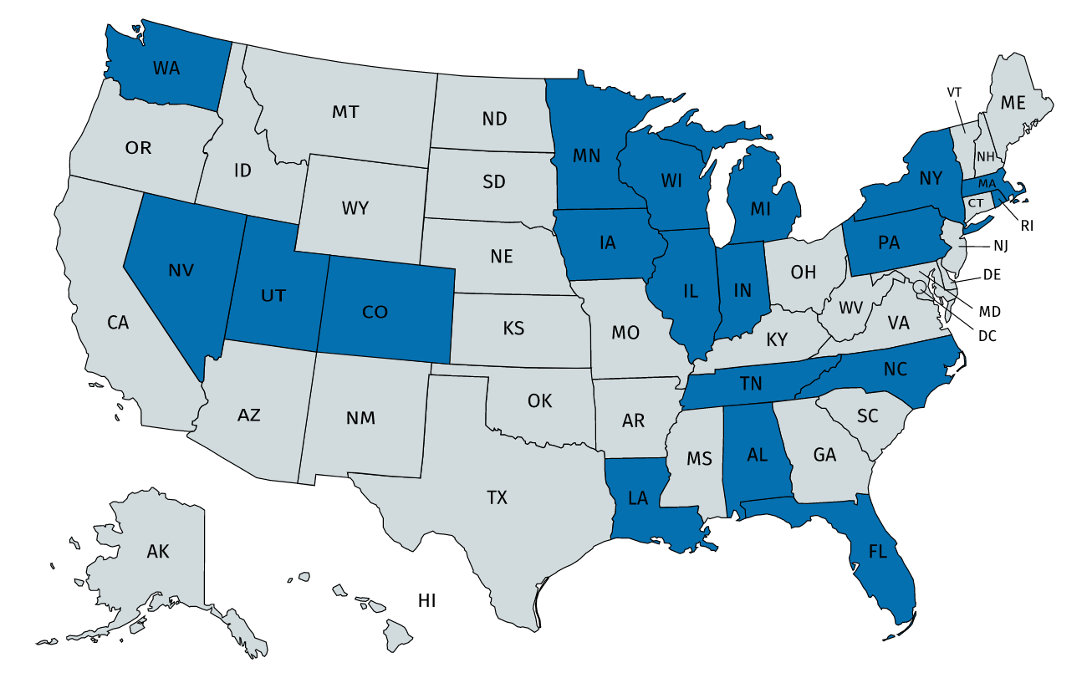
GRA Today: 24 Member Organizations in 19 States

Slide 5
GRA Agencies Come in All Sizes

Slide 6
And With Varying Resources

Slide 7
How do GRA Type User Groups Use Financial Statement Information?

Slide 8
Survey Questions
At what level of government does the organization focus?
What are the major areas of research and focus for the organization?
For approximately how many research studies a year does your organization use information contained in GAAP financial statements?
On a scale of 1-5, how important are GAAP based financial statements as a source of information for the organization’s research?
For approximately how may research studies a year does the organization use information contained in non-GAAP financial statements such as budget documents?
On a scale of 1-5, how important are non-GAAP based financial statements as a source of information for the organization’s research?
Please list up to three factors that would make your organization MORE likely to use GAAP based financial statements in future research.

Slide 9
Survey Respondents: Location and Level of Government Focus
LOCATION | LEVEL OF FOCUS
Louisiana | County
Tennessee | Other
Wisconsin | State and Local
Minnesota | State
Florida | State
New York | Other
Illinois | Municipal
Alabama | State
Utah | State

Slide 10
Reported Areas of Research Focus
Public finance; taxation and assessments; governance and policymaking; infrastructure; schools and other essential public services; public involvement in the private sector
Assist the General Assembly, the executive branch, and our local governments in studying issues and making recommendations concerning intergovernmental policy
Government finance, education, and economic and workforce development including transit issues with both a state and local focus.
State and local tax policy, state budget, state/local finance relationship, pension policy, efficiency in government, state workforce design, etc. Performance benchmarking on all of the above
Tax policy
Education, state budget issues, corrections, highways, as well as comparative local government issues. We also conduct some evaluation projects with state and local government and nonprofit agencies.

Slide 11
How Do GRA Organizations Report Using GAAP Based Financials?

Slide 12
How Do GRA Organizations Report Using Non-GAAP Based Financials?

Slide 13
Please list up to three factors that would make your organization MORE likely to use GAAP based financial statements in future research
Online user guides are always helpful. We have used GASB's summaries to help explain key concepts with fund balance, for example.

