Slide 1
The National Landscape of Criminal Justice Reform
2019 GRA Policy Conference
July 22, 2019

Slide 2
Who we are
The Crime and Justice Institute (CJI) at CRJ works with local, state, and national criminal justice organizations to reduce recidivism, cut costs, and promote public safety throughout the country
Since 2008, CJI has collaborated with Pew Charitable Trusts public safety performance project on the Justice Reinvestment Initiative (JRI) and other efforts
12 states with adult efforts and 10 states with juvenile efforts

Slide 3
The Prevailing View: 1970s –2000s
Rehabilitation doesn’t work
High rates of recidivism are inevitable
Prison is the only effective deterrent to crime

Slide 4
U.S. Incarcerated Population Soars
Source: Department of Justice, Bureau of Justice Statistics

Slide 5
By 2008: About 1 in 31 Adults Under Correctional Control
Source: Department of Justice, Bureau of Justice Statistics

Slide 6
State Correctional Spending Soars
$52 billion
Source: National Association of State Budget Officers

Slide 7
Despite Increased Spending, Recidivism Remained High
Source: Department of Justice, Bureau of Justice Statistics
Note: The range of years in this slide differs from those in previous slide.

Slide 8
Research on the Role of Incarceration
In general, incarceration is not more effective than non-custodial sanctions at reducing recidivism
For many lower-level offenders, incarceration can actually increase recidivism
Longer prison stays do not reduce recidivism more than shorter stays
Sources: Campbell Collaboration (2015); Drake & Aos (2012); Meade et al. (2012); Nagin, Cullen & Jonson (2009); Nagin & Snodgrass (2013); Nieuwbeerta, Nagin & Blokland (2009); Spohn & Holleran (2006)

Slide 9
Public Opinion Supports Rehabilitation
“It does not matter whether a nonviolent offender is in prison for 21 or 24 or 27 months. What really matters is the system does a better job of making sure that when an offender does get out, he is less likely to commit another crime.”
Source: 2012 Public Opinion Strategies/Mellman poll

Slide 10
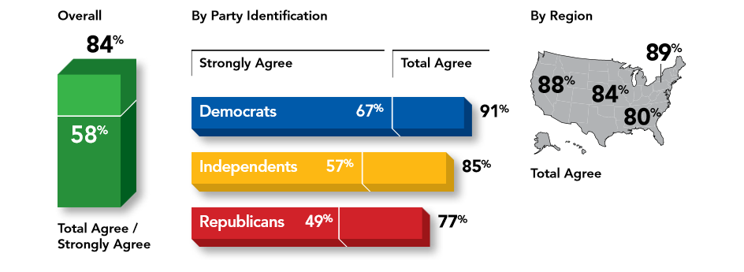
Support for Reform Strong Across Political Parties
“Some of the money that we are spending on locking up low-risk, nonviolent inmates should be shifted to strengthening community corrections programs like probation and parole.”
Source: 2012 Public Opinion Strategies/Mellman poll

Slide 11
Reframing the Debate
Old Question:
“How Do We Demonstrate that We’re Tough on Crime?”
New Question:
“How Do We Get Taxpayers a Better Public Safety Return on Their Corrections Dollars?”

Slide 12
Criminal Justice Policy Development
Improve Public Safety
Contain the Prison Population
Free Up Financial Resources
Fewer Crimes,
Fewer Revocations
Justice
Investment
Fewer Prison Beds

Slide 13
Key Reform Policy Areas
Sentencing
Release
Community Corrections
Sustainability

Slide 14
U.S. Incarcerated Population Drops
Source: Department of Justice, Bureau of Justice Statistics

Slide 15
U.S. Correctional Population Declines
Source: Department of Justice, Bureau of Justice Statistics

Slide 16
Crime Rates Do Not Increase
Source: Department of Justice, Federal Bureau of Investigation, Uniform Crime Reporting Statistics (UCR)

Slide 17
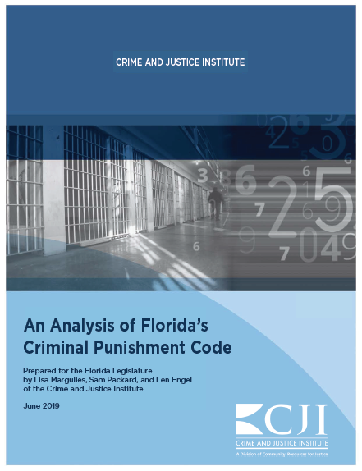
CJI’s Florida Reports
An Examination of Florida’s Prison Population Trends (2017)
Data-Driven Solutions to Improve Florida’s Criminal Justice System (2018)
An Analysis of Florida’s Criminal Punishment Code (2019)

Slide 18
Thank You
Lisa Margulies, Esq.
Senior Policy Specialist
Crime and Justice Institute (CJI)
617-455-8941
lmargulies@crj.org

