Slide 1
Medicaid Expansion and the Laboratories of Democracy

Slide 2
Timothy Michling, Research Associate
Citizens Research Council of Michigan
Master of Public Administration Wayne State University
Graduate Certificate in Public Health Practice
Master of Public Health candidate Wayne State University School of Medicine
Graduate Certificate in Urban Planning
Master of Music Bachelor of Music & Bachelor of Arts University of Michigan - Ann Arbor
Artist’s Diploma Colburn Conservatory of Music
Associate of Applied Science in Accounting Washtenaw Community College forthcoming

Slide 3
Citizens Research Council of Michigan
Founded in 1916
Conducts independent, non-partisan, fact-based research and analysis
Promotes sound policy for state and local governments through factual research that is accurate, independent, and objective
Relies on charitable contributions from individuals, businesses, and foundations
Contact: tmichling@crcmich.org
Learn more at: www.crcmich.org

Slide 4
Outline
The history and context of U.S. health care reform
Michigan’s experience with a key development in health care reform: Medicaid Expansion
Important considerations for evaluating health care policy
Alternative perspectives: Utah and Wisconsin
Q & A

Slide 5
Health Reform in the United States
A comprehensive history (…in five minutes or less, or the presentation is free!)

Slide 6
Many Attempts to Reform Healthcare System
Presidential Reformers
Theodore “Teddy” Roosevelt
Harry Truman
Lyndon Johnson
Richard Nixon
Jimmy Carter
Bill Clinton
Barack Obama

Slide 7
Medicaid
Title XIX of the Social Security Act – 1965
Created to provide health insurance to categorically needy individuals
Shared federal & state responsibility (all states participate)
Now the single largest source of health insurance in U.S., covering more than 1 in 5 Americans
State coverage ranges from 11% in Utah to 34% in New Mexico
More than 2 in 3 Medicaid enrollees get care through private managed care plans
Notes:
24% in Mississippi even without expansion 47% in Puerto Rico

Slide 8
The Affordable Care Act of 2010
Overarching Goals
Reform Mechanisms
Universal Coverage (Access)
Service Delivery and Value (Quality)
Affordability (Cost)
Market Reforms
Pre-existing conditions
Individual mandate
Marketplace Creation
Health Exchanges
Medicaid Expansion

Slide 9
Components of the Affordable Care Act
Major Market Reforms
A Delicate Balance:
Guaranteed Issue
Individual Mandate
Continued Reliance on Employers:
Shared Responsibility Provisions (Employer Mandate)
Dependent Coverage to age 26
10 Essential Health Benefits
No Lifetime/Annual Limits
No Cost-Share for Prevention
Premium Rating Rules
Summary of Benefits Coverage
Medical Loss Ratio Restrictions

Slide 10
Components of the Affordable Care Act
New Marketplaces
Medicaid Expansion
Individual Marketplace
11,444,141 Americans selected a marketplace plan for 2019 (including 1,783,304 in Florida—highest in the nation)
Small Business Health Options Program (SHOP) Marketplace
Small Business Health Care Tax Credit
Mandatory Expansion of Medicaid Became Optional for States
National Federation of Independent Business v. Sebelius
Substantial Variability in State Medicaid Programs
Notes:
https://www.kff.org/health-reform/state-indicator/marketplace-enrollment/?currentTimeframe=0&sortModel=%7B%22colId%22:%22Location%22,%22sort%22:%22asc%22%7D

Slide 11
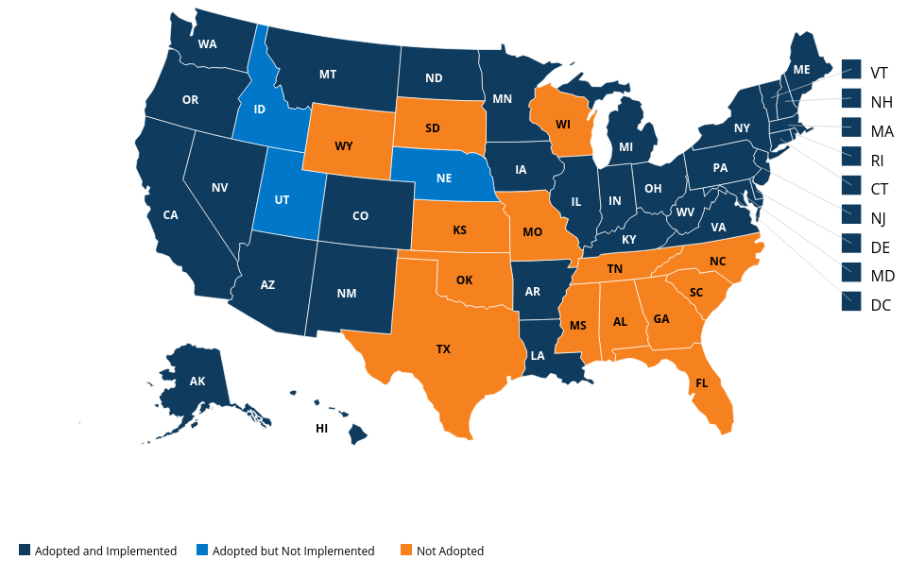
Current Status of State Medicaid Expansions
36 States (plus the District of Columbia) have expanded/are expanding Medicaid
Several states used Section 1115 Demonstration Waivers to deviate from federal guidelines
Maine became first to expand by ballot initiative in 2017
Interesting developments in Utah, Wisconsin, Kentucky, and Arkansas
Source: Kaiser Family Foundation
Notes:
Source: Kaiser Family Foundation

Slide 12
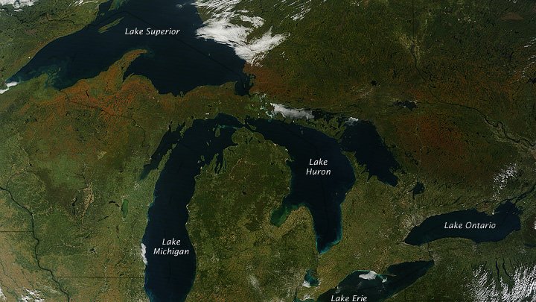
Michigan’s Experience
The “Healthy Michigan Plan”

Slide 13
Medicaid in Michigan
Public Act 321 of 1966, Section 105
Traditionally for low-income children, elderly, & the disabled
Largest source of funding for long-term care
Coverage for ~44 percent of all births in Michigan
Today:
1.7 million Medicaid enrollees in Michigan
Program cost of $17.8 billion (FY2019)
~$4 billion of this is for the Healthy Michigan Plan

Slide 14
Medicaid Expansion in Michigan: The “Healthy Michigan Plan”
Signed by Governor Snyder in September of 2013
Expanded Michigan’s Adult Benefits Waiver program
Program implementation began April 2014
Expanded adult eligibility, including childless adults
Income at or below 138 percent of the federal poverty level
Covers around 650,000 beneficiaries

Slide 15
Change in Proportion of Uninsured Persons
Implementation Timeline
2010: ACA Becomes Law Many Market Reforms occur within 180 days.
2011: Dependent coverage to 26; no annual/lifetime limits.
2014: Health Insurance Exchanges Open; Medicaid Expanded (in some states); Insurance must cover pre-existing conditions and individuals must purchase health insurance.
2015: Employer Shared Responsibility Begins.
U.S. and Michigan, 2010-2016

Slide 16
Sources of Insurance in Michigan, 2015
The majority of Michiganders get insurance from their employment
Many Medicare beneficiaries receive additional support from Medicaid – known as “dual eligibles”
The number of people without insurance in Michigan is roughly equal to the number purchasing individual insurance plans
Notes:
Today: 51% Employer, 15% Medicare, 22% Medicaid, 5% non-group, 5% uninsured, 1% other public

Slide 17
Section 1115 Demonstration Waivers
Choose your own [Medicaid] adventure!

Slide 18
Healthy Michigan Plan: Unique Characteristics
Section 1115 Demonstration Waiver
Cost-Sharing
Health Risk Assessments
Addressing Social Determinants of Health
Cost/Savings Sunset Mechanism
Work Requirements

Slide 19
The Healthy Michigan Plan: Cost-Sharing
Two Types of Cost-Sharing
Characteristics
Co-pays
All beneficiaries
Fixed amount based on utilization
No co-pay for preventative or emergency services
“Premium” Contributions
Income above 100 percent FPL
Based on income and household size
Cost-sharing and premiums are not to exceed 5 percent of household income
MI Health Account
Aims to facilitate beneficiary education and responsibility
Quarterly statements
Payment by mail or online
Consistent failure to pay results in garnishment by MI Department of Treasury
Benefits are not terminated

Slide 20
The Healthy Michigan Plan: Co-Pays
$2

Slide 21
The Healthy Michigan Plan: Health Risk Assessment
Mechanism
Healthy Behavior Examples
Beneficiaries are encouraged to complete a Health Risk Assessment
Beneficiaries can choose one or more behaviors to address
Primary care provider provides attestation of Health Risk Assessment and plan to address behavior(s)
Weight loss
Tobacco cessation
Address substance abuse
Stop alcohol use/abuse
Chronic condition follow-up
Immunization (flu vaccine)

Slide 22
The Healthy Michigan Plan: Social Determinants of Health
Contract for Medicaid Managed Care Organizations includes:
Population health management
Inclusion of social determinants of health in data analytics
Admonition of health equity and disparity reduction goals

Slide 23
The Healthy Michigan Plan: Sunset Mechanism
Mechanism
Net Savings
Program immediately terminated if:
Net costs exceed net savings
Savings determined by MDHHS and State Budget Office
Savings criteria purely fiscal and ignores numerous program benefits

Slide 24
Medicaid Work Requirement
A forthcoming evolution or forgone conclusion?

Slide 25
Work Status and Reason for Not Working Among U.S. Non-SSI, Nonelderly Medicaid Adults, 2017
Notes:
Source: Kaiser Family Foundation https://www.kff.org/medicaid/issue-brief/medicaid-and-work-requirements-new-guidance-state-waiver-details-and-key-issues/

Slide 26
Michigan Medicaid Expansion Enrollee Work Status, 2016 among those with at least 12 months of coverage
Total = 379,627
Notes:
Source: Tipirneni et al., JAMA Internal Medicine https://jamanetwork.com/journals/jamainternalmedicine/article-abstract/2664514?redirect=true

Slide 27
Characteristics of “Out of Work” Healthy Michigan Plan Beneficiaries
More Likely to be Older, Male, in Fair/Poor Health, and Have Chronic Health Conditions and/or Functional Limitations
74 Percent Had a Chronic Health Condition
65.1 Percent Had at Least One Physical Condition
35.3 Percent Had at Least One Mental Condition
24.4 Percent Had a Physical Functional Impairment
25 Percent Had a Mental Impairment
Notes:
Source: Tipirneni et al., JAMA Internal Medicine https://jamanetwork.com/journals/jamainternalmedicine/article-abstract/2664514?redirect=true

Slide 28
Potential Consequences of Medicaid Work Requirements
Increased Administrative Burden
Termination of Benefits to Qualified (Working or Disabled) Individuals
Discontinuity of Care and Worsened Health Outcomes
Increased Emergency Room Utilization/Uncompensated Care

Slide 29
Understanding and Evaluating Health Care Policies and Reforms
Doctor, Doctor: Give me the news…

Slide 30
Three Pillars of Health Care Evaluation
Cost
Access
Quality
Viewed by some as a case of “pick only 2”

Slide 31
Medicaid is an Enormous Expense for States
Notes:
FY2019

Slide 32
Medicaid is an Enormous Expense for States
Of Michigan’s $19.2 billion in health care services spending, 71% is for traditional Medicaid and another 22% for Medicaid expansion
70% of the $19.2 billion comes from federal sources
16% ($3.1 billion) comes from the state general fund
FY 2019 general fund cost for Medicaid Expansion: $192 million
Costs are offset by $403 million in budget savings, including:
$168 million savings for mental health funding
$47 million for Adult Benefits Waiver program
$19 million for prisoner health care costs
Average cost per Medicaid beneficiary has increased by 46% since FY2001, yet this is far below the rate of general medical cost inflation

Slide 33
Average Cost per Enrollee in Michigan by Medicaid Group, FY2016
Notes:
Source Data: MDHHS
Seniors and people with disabilities make up 1 in 4 beneficiaries but account for almost two-thirds of Medicaid spending

Slide 34
The Healthy Michigan Plan: Economic Impacts
Macroeconomic benefit from infusion of federal dollars
Job creation and increased personal income
Substantial reduction in uncompensated care
Bolstered rural hospitals and health providers
Cost reduction for private health plans
Workforce impact?
Evidence suggests that Medicaid expansion removed health-related barriers to work for some
Other argue that continued eligibility is a disincentive to work
Research on labor markets suggests either a positive or neutral net effect

Slide 35
The Healthy Michigan Plan: Enrollment and Access
Enrollment
Access
645,504 enrollees (as of 7-15)
Around 1/3 of Medicaid beneficiaries
Program surpassed first year enrollment goal of 322,000 in the first 100 days.
Almost half of enrollees are 19-34 in age
Usual source of care
Appointment availability
Affordable
Preventative health services
Medication adherence
More ambulatory care visits
Timely medical interventions

Slide 36
The Healthy Michigan Plan: Health Outcomes
Morbidity
Mortality
Increased utilization of health screenings and prevention
Improved mental health
Improved self-reported health status
Chronic condition management – mixed evidence
Reasonable criteria?
Reduced mortality
Aall-cause mortality
Life expectancy and Premature Years of Life Lost
7,000 – 17,000 estimated excess deaths in states that did not expand Medicaid during the first year.

Slide 37
Cost, Access, and Quality aren’t enough
Michigan ranks better than average on measures of health care cost and access
In terms of quality, Michigan also has some of the highest ranked hospitals in the nation
Michigan Medicine recently ranked #5 on the Hospital Honor Roll from US News Health
Yet, clinical care only accounts for a fraction of modifiable health outcomes

Slide 38
Health Indicators in Michigan
8th highest rate of death due to heart disease
15th highest rate of cancer death
Michigan exceeded national average for deaths from chronic lower respiratory disease, diabetes, kidney disease, and influenza/pneumonia
Also exceeded the national average for drug overdoses, firearm deaths, and homicides
A third of adults in Michigan are obese
One in five adults in Michigan use tobacco
Infant and maternal mortality in Michigan exceed the national average
Important racial disparities
Residents in Michigan have a shorter life expectancy at birth

Slide 39
Social/Environmental Factors Explain a Substantial Portion of Michigan’s Health Outcomes
Impact of “Upstream” Factors
Social Determinants of Health
Smoking is strongly associated with socioeconomic position—consider smoking prevalence by educational attainment:
Less Than High School: 41.1%
High School: 26.9%
4-year Degree or Higher: 7.5%
Obesity is strongly associated with:
Poverty and stress
Social and behavioral norms
Obesigenic environments (e.g. unwalkable food deserts/swamps)
Infant mortality varies substantially by socioeconomic status, race, and geography:
Michigan: 6.4 deaths per 1,000 live births
Detroit: 12.7 deaths per 1,000 live births
Basic Needs (Safe Housing and Food)
Economic Conditions (Poverty and the Stress that Accompanies Poverty)
Quality of Education and Job Training
Availability of Social Support and Community Resources (Family, Church, Public Spaces)
Social Norms (Discrimination, Racism, Attitudes on Education, Distrust of Government)
Public Safety/Exposure to Violence/Crime
Language, Literacy
Culture

Slide 40
Age-Adjusted Mortality Rates for the Ten Leading Causes of Death in Michigan, 2016
 | U.S. | Michigan | Detroit
Heart Disease | 165.5 | 200.8 | 322.9
Cancer | 155.8 | 167.1 | 192.7
Chronic Lower Respiratory Diseases | 40.6 | 44.7 | 33.9
Unintentional Injuries | 47.4 | 50.8 | 71.9
Stroke | 37.3 | 39.1 | 47.4
Alzheimer's Disease | 30.3 | 33.8 | 20.1
Diabetes Mellitus | 21.0 | 21.5 | 27.6
Kidney Disease | 13.1 | 14.5 | 23.5
Pneumonia/Influenza | 13.5 | 13.7 | 21.0
Intentional Self-harm | 13.5 | 13.4 | 8.9
All Causes of Death | 728.8 | 787.8 | 1,027.4
Notes:
Per 100,000 population

Slide 41
Michigan Within-County Life Expectancy Disparities
County | Lowest Neighborhood Life Expectancy at Birth | Highest Neighborhood Life Expectancy at Birth | Life Expectancy Gap (in years)
Wayne | 62.0 | 87.1 | 25.1
Washtenaw | 67.4 | 89.0 | 21.6
Oakland | 65.7 | 86.8 | 21.1
Genesee | 64.7 | 84.0 | 19.3
Berrien | 67.6 | 86.7 | 19.1
Macomb | 66.8 | 85.7 | 18.9
Kent | 73.2 | 90.8 | 17.6
Monroe | 64.4 | 82.0 | 17.6
Saginaw | 66.4 | 83.7 | 17.3
Ingham | 69.7 | 86.6 | 16.9
Data Source: U. S. Small-area Life Expectancy Estimates Project, National Vital Statistics System

Slide 42
U.S. Life Expectancy at 25 by Education Level

Slide 43
Smoking by Education Level, 2017 U.S. and Michigan

Slide 44
Tobacco Use and Degree Attainment, 2017 Great Lakes States

Slide 45
Medicaid: A Vehicle for Health Care Innovation?
Reshape health care to acknowledge and address the root causes of poor health
Work “upstream” to prevent long-term adverse consequences
Integrate physical and behavioral health services (and incorporate social services)
Identify “super-utilizers” to provide targeted support
Focused investment can lower overall spending

Slide 46
Public Health Paradigm
Health in All Policies
Public Health 3.0
Collaborative approach to public health
Broadly incorporate public health perspective into policy formulation and implementation
Diverse policies (education, transportation, criminal justice, urban planning, taxation) have important health consequences
Planned strategically, policies can protect/enhance community health
Public Health 1.0: Establishment of basic sanitation and population health improvements
Public Health 2.0: Professionalization of Public Health Departments
Public Health 3.0: A new strategic paradigm?
Forge partnerships across sectors
Overcome health inequalities and inequities

Slide 47
Citizens Research Council of Michigan
Publications are available free of charge on our website:
www.crcmich.org
Follow Us on Twitter: @crcmich
Like us on Facebook:
www.facebook.com/crcmich
Providing Independent, Nonpartisan Public Policy Research Since 1916

Slide 48
Medicaid in Utah
GRA Conference – 2019

Slide 49
Targeted Adult Population Expansion
2017: Legislature passed a limited expansion
Below 5% of federal poverty and:
Chronically homeless
On probation or parole and in need of substance abuse or mental health treatment
In need of substance abuse of mental health treatment

Slide 50
Partial Medicaid Expansion
2018: Legislature passed H.B. 472
Increased income eligibility to 100% of FPL
Requested budget and enrollment caps
Requested work requirements
Requested federal match rate of 90%
Bill required approval from Centers for Medicare & Medicaid Services

Slide 51
CMS Approved Partial Expansion
100% FPL income limit
Budget cap
Work requirement
70 – 30 match

Slide 52
Proposition 3: Full Medicaid Expansion
November 2018: Voters approve full Medicaid expansion
Vote of 53% to 47%
Persons under the age of 65 and with incomes equal to or below 138 percent of the federal poverty line.
Increase the sales tax from 4.70% to 4.85% to finance the state's portion of the costs to expand Medicaid
However: Utah is one of 11 states that have no restrictions on legislative alterations

Slide 53
Partial Medicaid Expansion – Part 2
2019: Legislature passed S.B. 96 – Repeal and replace
Covers up to 100% FPL
Enrollment and budget caps
Work requirements
Requests federal match rate of 90%
Requires approval from Centers for Medicare & Medicaid Services

Slide 54
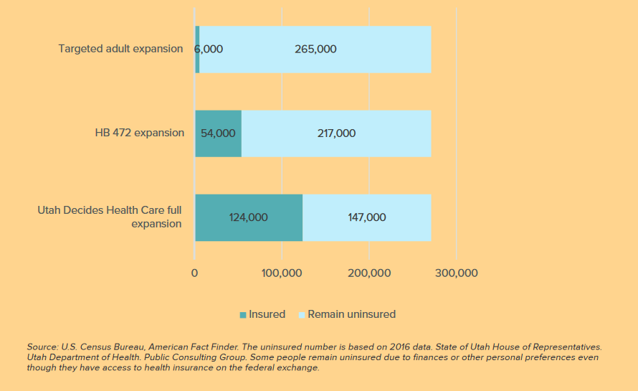
Differences in Coverage
Targeted
Partial
Prop 3

Slide 55
Differences in Coverage
Targeted
Partial
Prop 3

Slide 56
GRA Presentation
Wisconsin’s unusual approach to Medicaid expansion

Slide 57
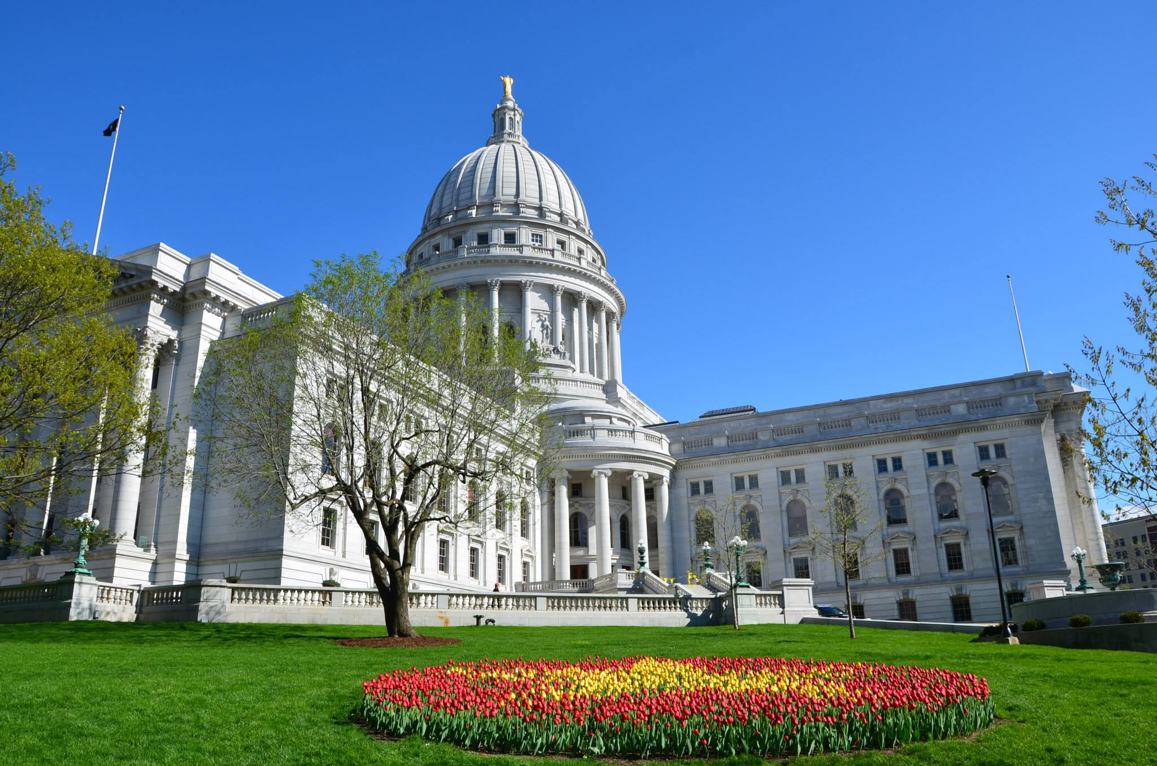
Wisconsin pre-Affordable care act
Wisconsin historically has had a robust Medicaid program:
“BadgerCare” Medicaid expansion under then Gov. Tommy Thompson
“BadgerCare Plus” expansion under then Gov. Jim Doyle. Many WI adults (including some without children) covered up to 200% FPL. But many childless adults couldn’t access coverage.

Slide 58
Wisconsin’s Unique response to ACA
In 2014, Wisconsin both expanded and cut Medicaid:
All adults above 100% of FPL are shifted into ACA exchanges (including those at 100%-133% FPL)
All childless adults below 100% FPL become eligible for Medicaid (no more waiting list), some benefit differences
WI only state to take this approach (reject expansion $)

Slide 59
Pros and Cons
WI added on net 19K to Medicaid:
On one hand, WI not vulnerable to potential change in ACA’s higher fed reimbursement rate
Low Medicaid provider rates
On other, WI has foregone roughly $1.1B in state Medicaid savings (2014-19)
Evers proposal (save state taxpayers $324M over two years and cover 82K more state residents)

Slide 60
Spending would dip under evers plan
GPR Medicaid Appropriations (In Millions), 2012-2021

Slide 61
Final budget to see more state spending
GPR Medicaid Appropriations (In Millions), 2012-2021

Slide 62
Competing Research
Recents months have seen dueling studies on Medicaid question:
WILL/CROWE (UW-Madison) – Cost shift of Medicaid expansion would hit private insurers and their customers
UW-Madison – Review of previous study finds it failed to account for the effects of medical inflation and increased ER usage nationally

