Slide 1
Hacking Maps for People on a Budget or a Deadline
July 22, 2019
Governmental Research Association
St. Petersburg, Florida
Joe Adams, Ph.D.
Public Affairs Research Council of Alabama

Slide 2
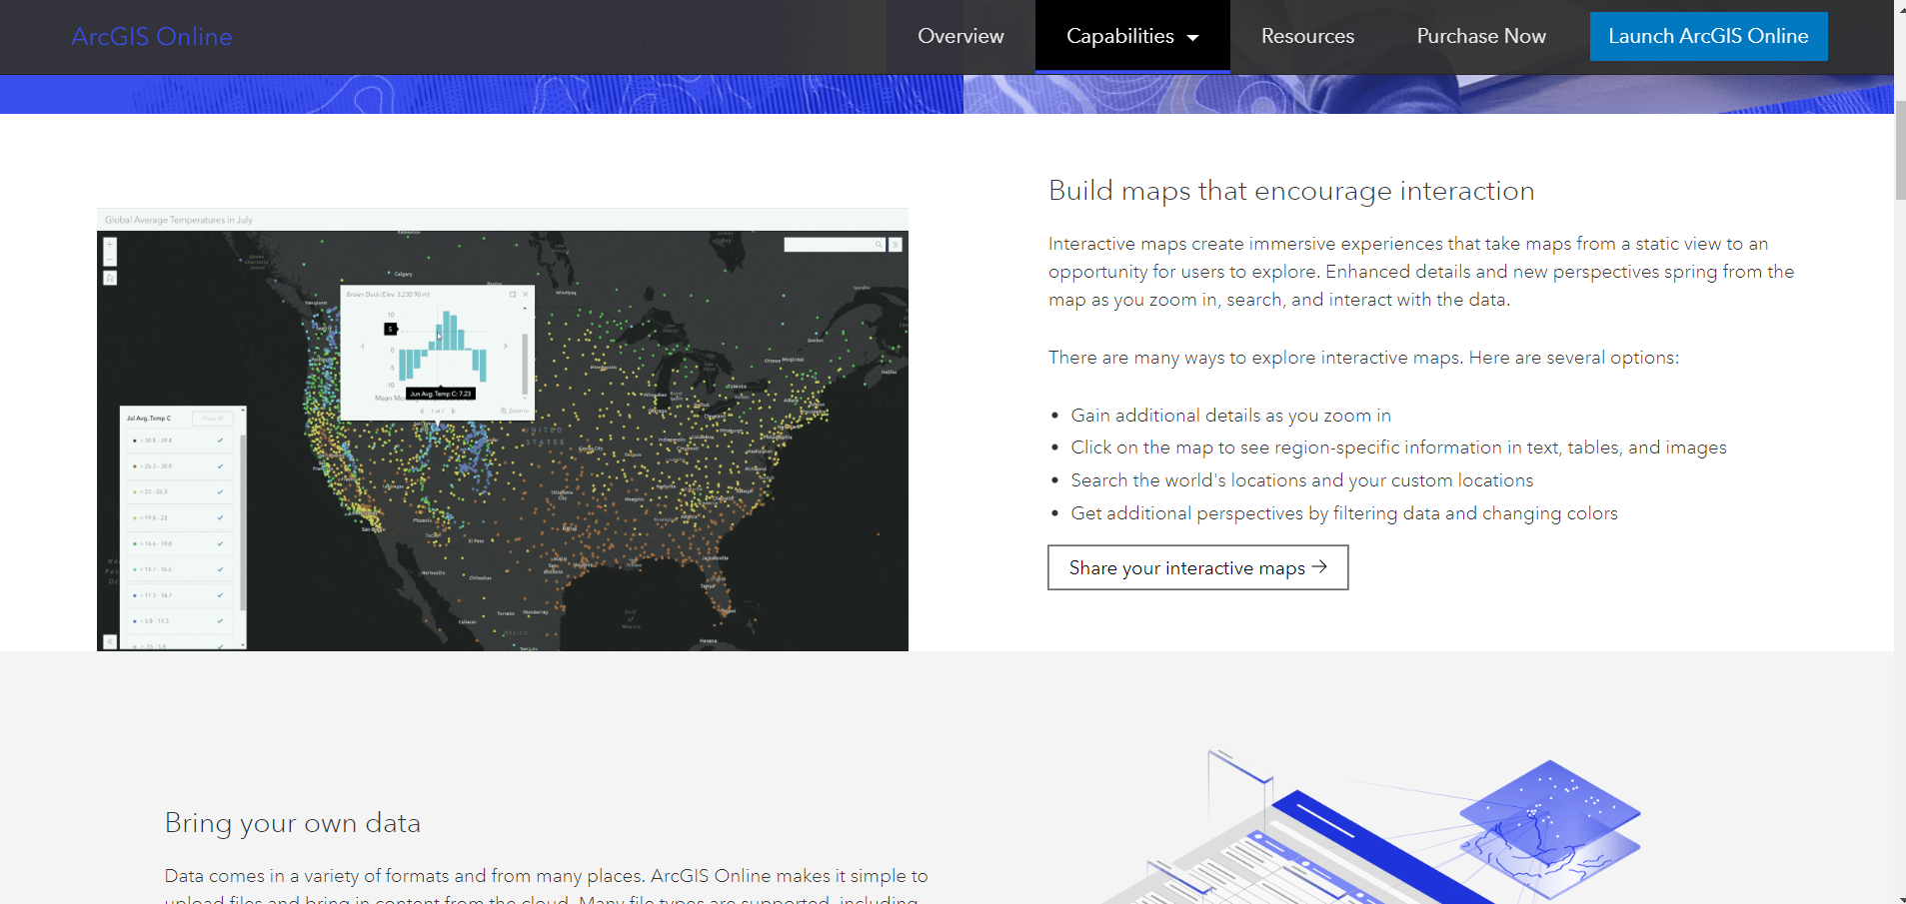
ERSI & ArcGIS
Notes:
If you are skilled in using ERSI/ArchGIS you’re in the wrong room. This is for people who are thinking about making maps, without any background or training. People like me.

Slide 3
Purpose Matters
Find locations?
Compare populations by location?
Overlay data geographically?
Notes:
Knowing how you want to use a map is essential to choosing the right tools. Different tools have different capabilities, skill requirements, and software costs.

Slide 4
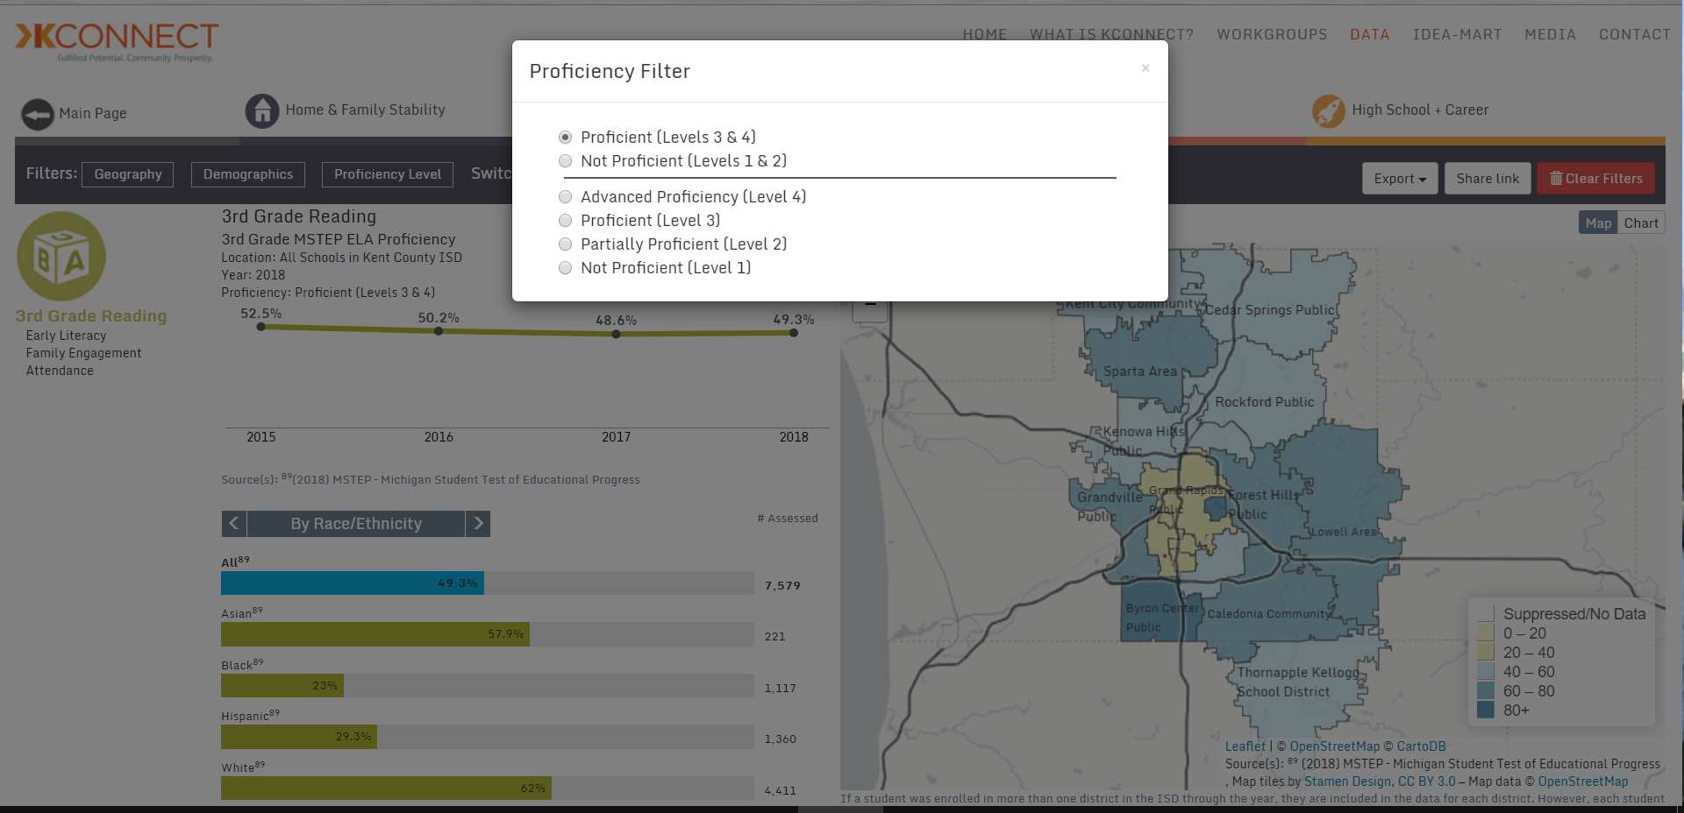
Looks like Tableau (Sort of)
Notes:
A few months ago, I participated in a webinar for a StriveTogether partner in Michigan that displayed their data dashboards. Most of the people on the call, mainly Tableau Fellows from Strive’s first cohort of partners using Tableau as a gift from the Tableau Foundation. The dashboards looked a lot like this. As we were looking at them, we could tell that they weren’t built with Tableau, so we asked how they were constructed. I started, then my colleague from New Mexico chimed in too to ask about the team that put it together. There were ten of them, with a budget of $100,000 a year.

Slide 5
A sample of the skills used for mapping.
HTML5
Oracle Database
Java scripts
PostgreSQL
PostGIS
SpatialSQL
QGIS processing models
Python processing scripts
ArcGIS
Notes:
These are a few of the skill sets that their team members had. Not all of us have the luxury of hiring a big team or the time to become experts in such a wide variety of software and database systems. What can we do fast and cheap that does what we need?

Slide 6
On the Cheap and in a Hurry: BatchGeo
Location details
Summary data
Cut & Paste from Excel
Embed into website
Notes:
One of the easiest options is BatchGeo. PARCA used this about ten years ago for a project where we were trying to do some asset mapping for social services, starting with child care and pre-k.

Slide 7
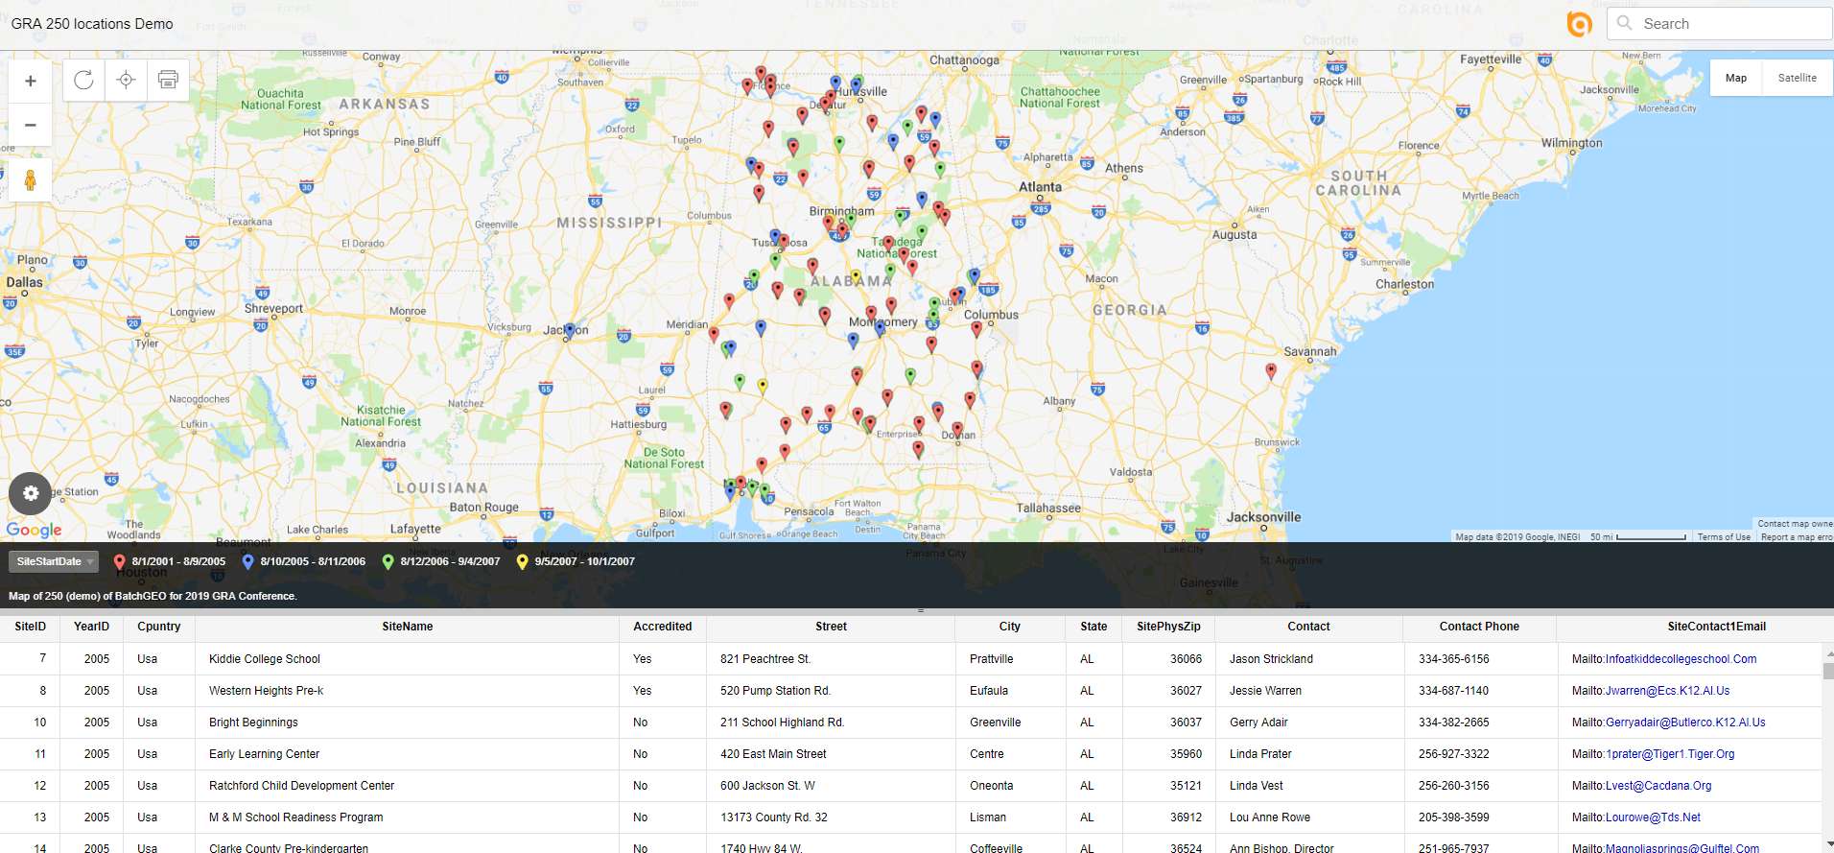
Demo with 250 (free) locations
Notes:
You can use the demo version to map up to 250 locations and embed the results in a webpage

Slide 8
10 users passcode PDF support
Based on Google Maps
Notes:
It’s based on GoogleEarth. The professional version, which allows 10 users, costs $99 per month. We used it for about 18 month.

Slide 9
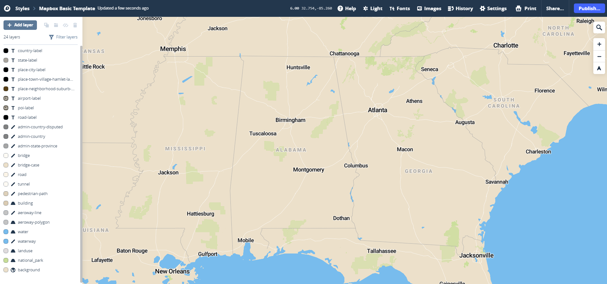
A bit more expensive: Mapbox
Mapbox – Easy for Pure Mapping
Notes:
Mapbox has some built-in layers that can jazz up your map with a variety of geographic features.

Slide 10
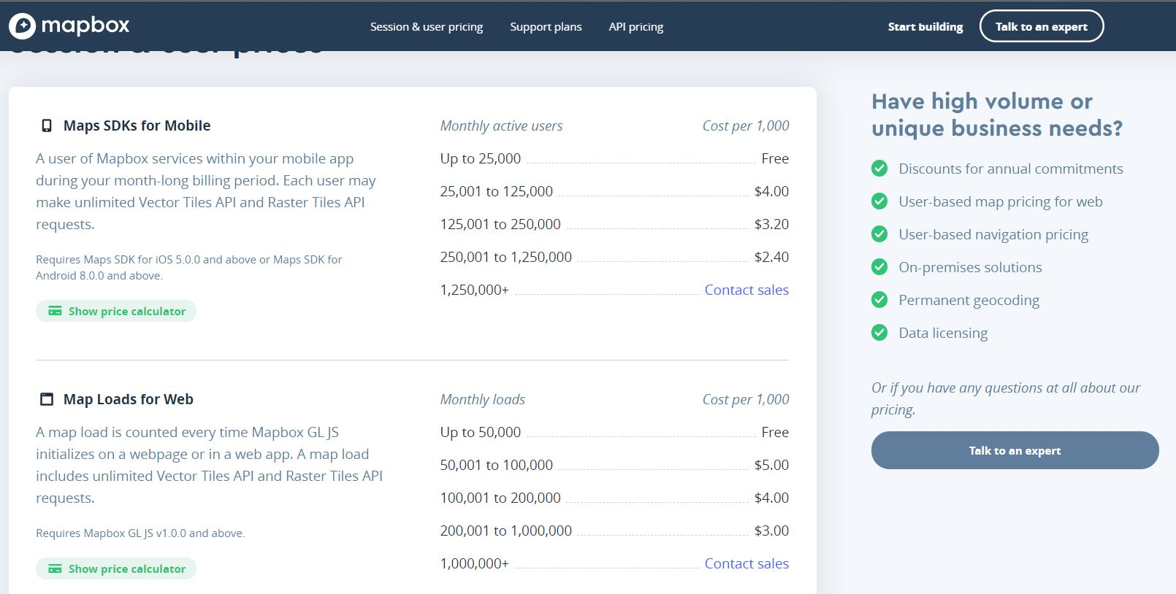
Mapbox has Scalable Pricing
Up to 25,000 visits – free
Up to 50,000 loads – free
Cost per 1,000 visits – sliding scale
Cost per 50,000 loads – sliding scale
Notes:
Mapbox pricing is usage based, on visits (users) and uploads, everything is priced at per 1,000 with different levels of cost.

Slide 11
Nonprofits can get free annual license.

Slide 12
Alteryx is a great data cleaning and analysis tool. R runs on the back end and everything is icon based.

Slide 13
Alteryx Spatial Capabilities

Slide 14
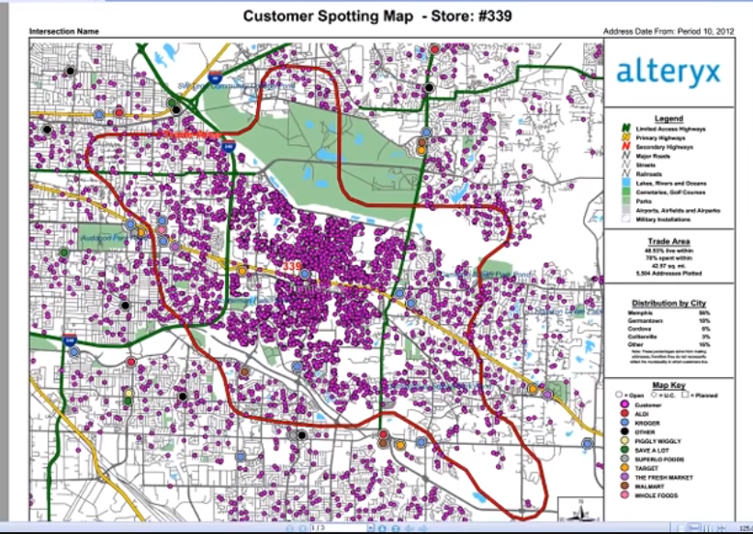
Free version does not have commercial data package.

Slide 15
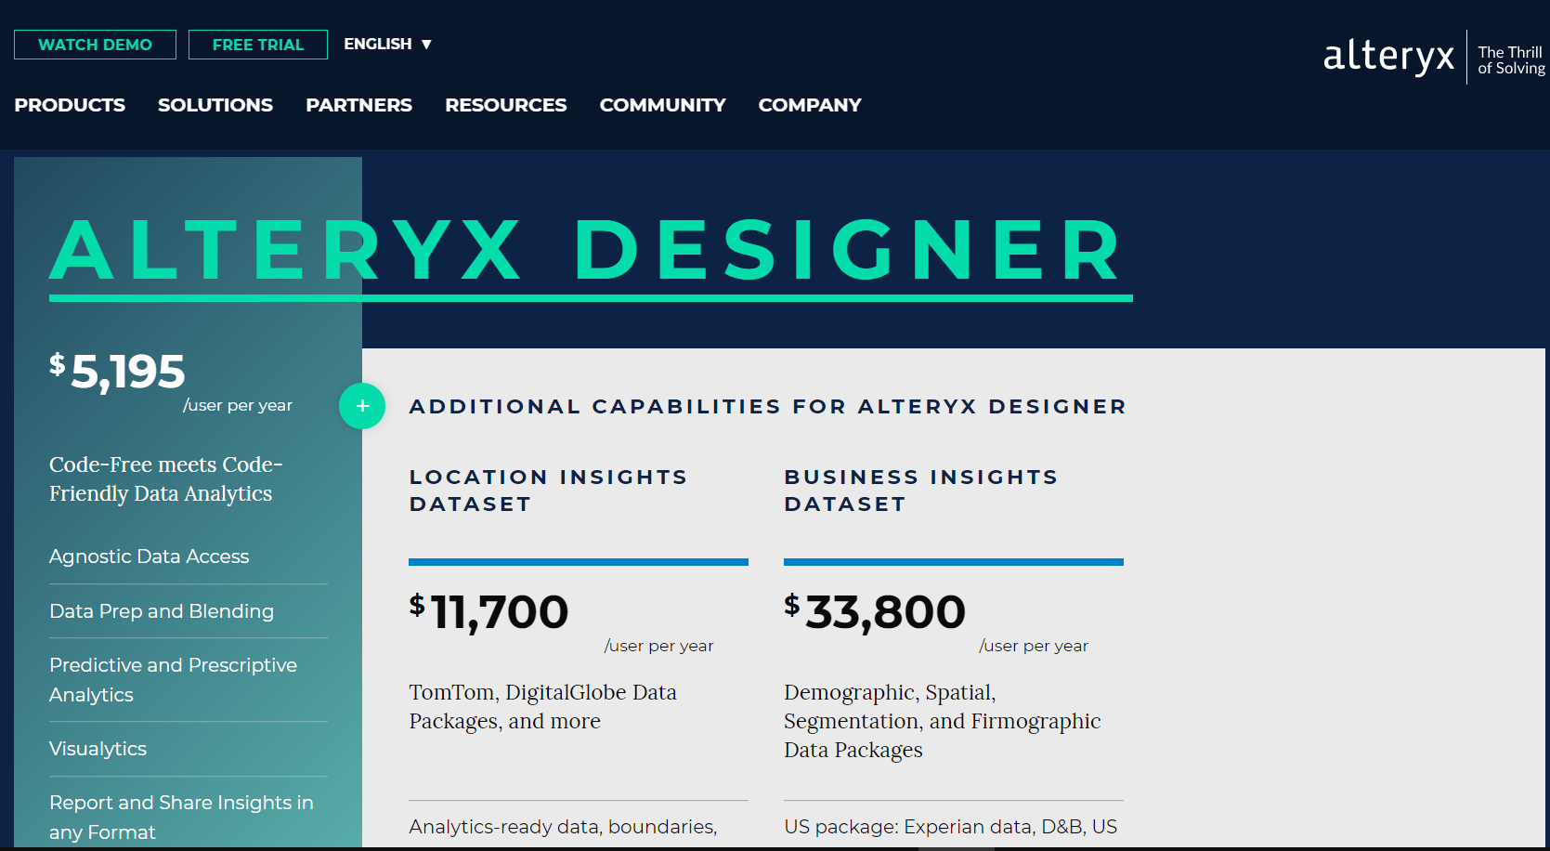
Full commercial version is $33,800/yr

Slide 16
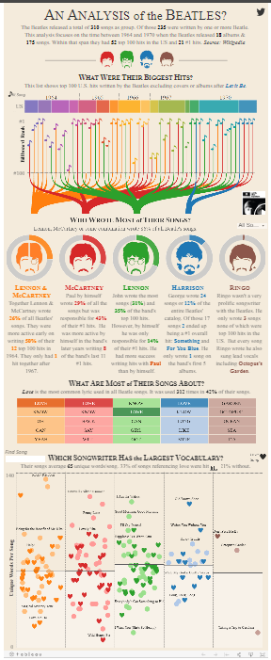
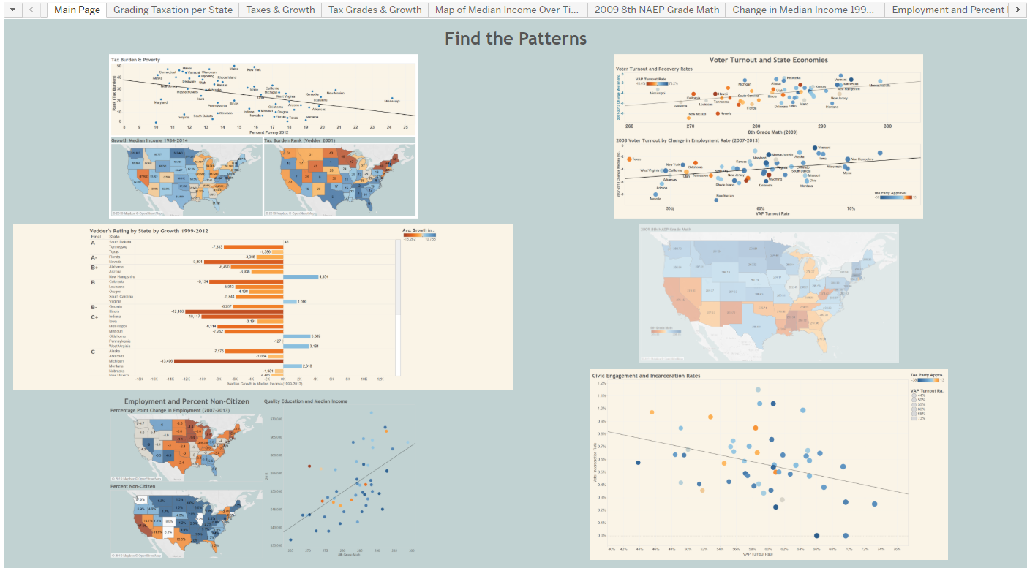
Tableau – Middle Ground
Best data viz, maybe of all time.
Notes:
I discovered Tableau about five years ago, and fell in love. One night I put together a lot of data on the financial recovery, looking at how Richard Vedder scored them on taxation.

Slide 17
Matching Programs & Geography

Slide 18
We see the same places with problems.

Slide 19
Year After Year

Slide 20
A Tableau Tour

Slide 21
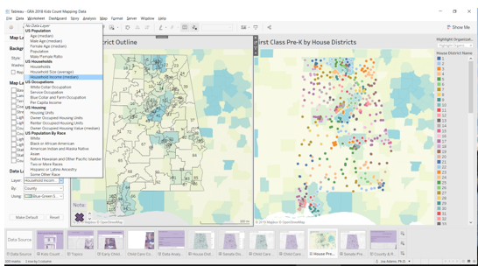
Tableau has built-in layers to choose.
Custom layers can be added.
Dual axis maps (overlays) can be dynamic using parameters to choose fields to shade backgrounds.

Slide 22
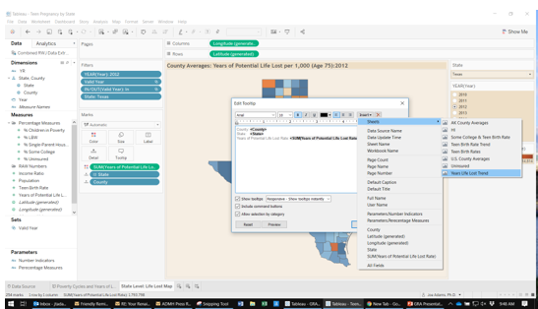
Creating flashy features is easy…
Inserting a “Viz in a Viz” object is relatively easy.
Create the sheet with the trend or bars
On the tooltip, add that sheet to the items in the tool tip.
Done

Slide 23
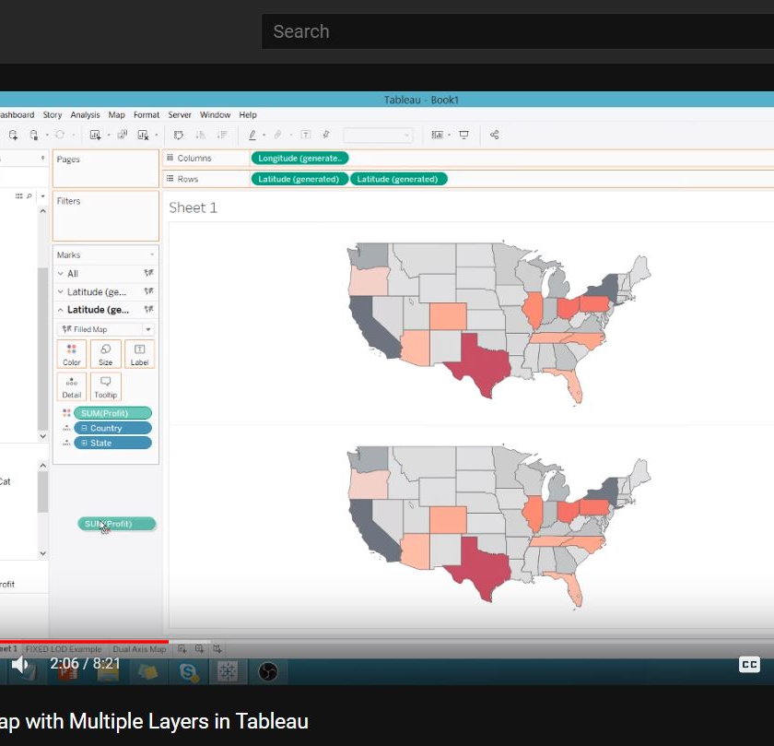
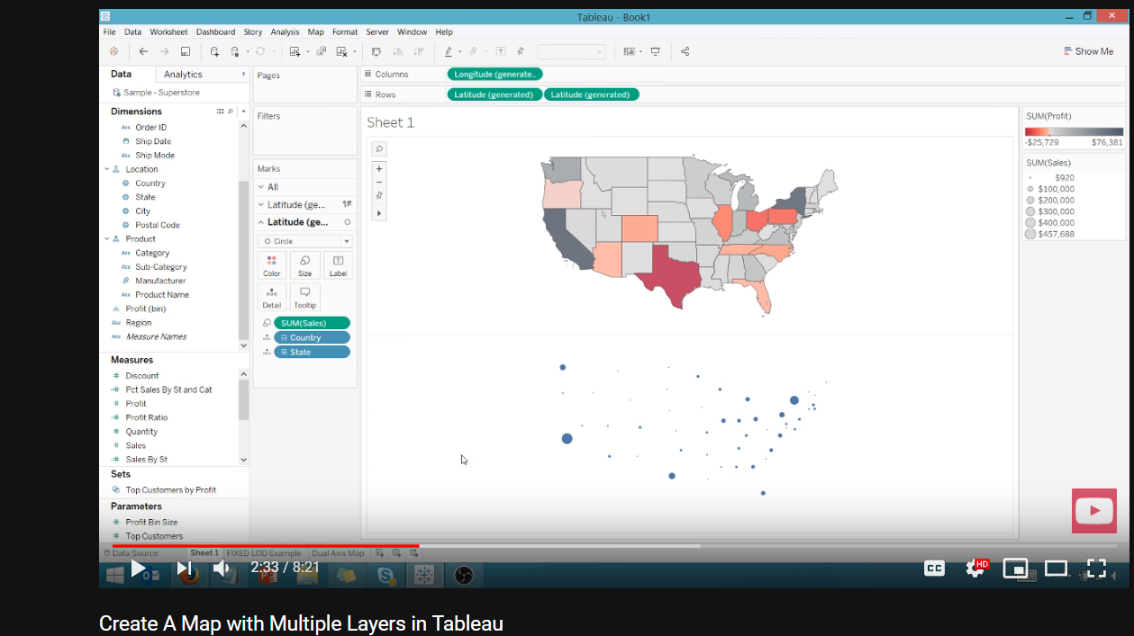

Slide 24
And then there’s Olga Tsubiks
Notes:
Olga Tsubiks has a website that will walk you through lessons on how to use Tableau, for free. When you’re done, you should be able to pass the certification. I’ve sampled it and she’s really good at teaching the tricks.

Slide 25
Other Resources
GeoCommons is a community contributed collection of open data from around the world. Uploaded by the public, data are often from public and open government website and sources. The searchable archive includes over 150,000 datasets as GeoJSON stored in Github and available to preview, download or explore in ArcGIS.com.
Polymaps is JavaScript library for image- and vector-tiled maps using SVG.
Unfolding is a library to create interactive maps and geovisualizations in Processing and Java
OSGIS is an open source software from the Netherlands. See this video introduction.
Notes:
I found some other high-quality data and software resources that you might explore as alternatives.

Slide 26
13 Free GIS Options

Slide 27
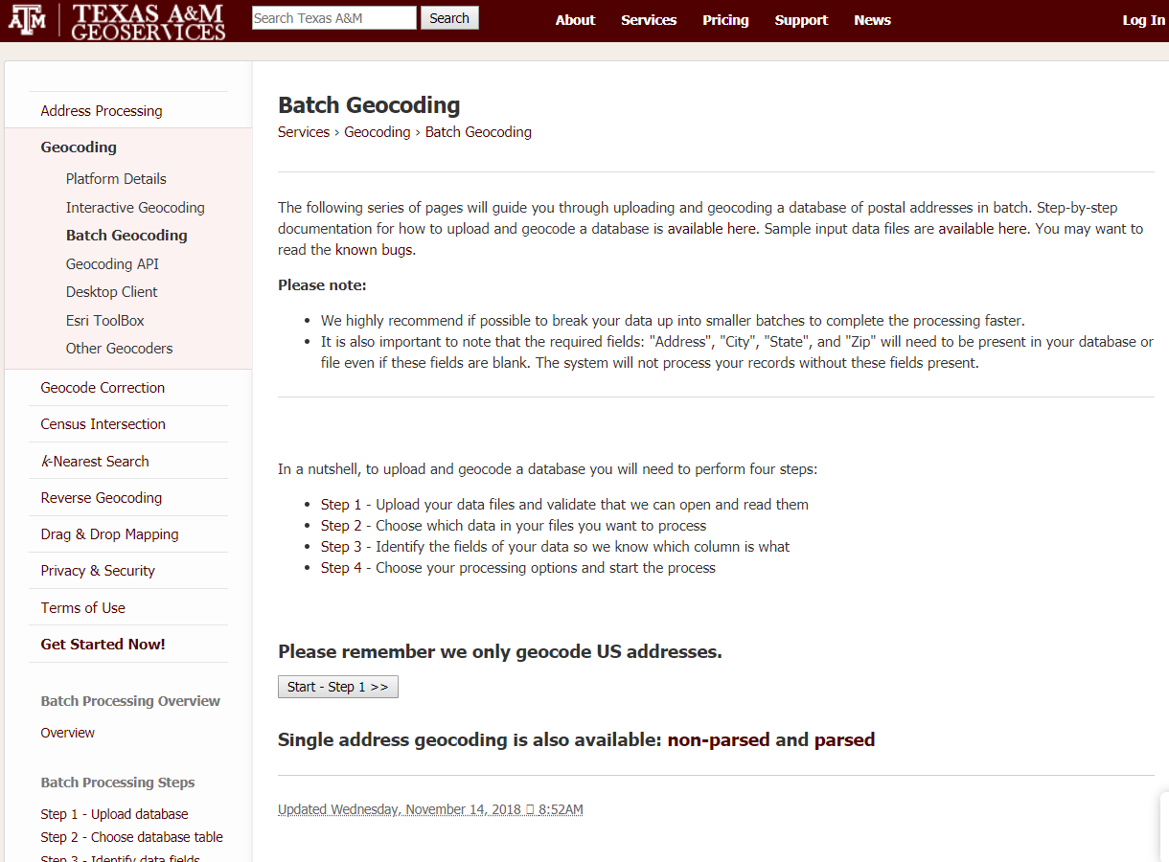
Messy data? Geocoding Services
Census geocoding is free, available in batch mode for about 10,000 records each.
Texas A&M Geoservices runs a geocoding service and has a long list of other geocoding services.
Notes:
Census Geocoding is free, and Texas A&M University Geoservices is free for the first 1,000 addresses and has a list of other geocoders that you might want to use.

Slide 28
Decision Factors
Know how you want to use a map.
Consider life-cycle of project.
Consider learning as investment.
Consider classroom time at 20-30%
Consider the value versus the cost
Notes:
To choose your best option, consider the following factors. How will you use the map? Is this an ongoing project? How long will they last and will they be updated later? Consider the time and money in choosing your option as an investment in both the software and the training. When you think about how long it takes to learn how to use, the experts in the field say that classroom training is about 20 – 30 percent of how long it takes. You have to practice to get good at it. Taking all that into consideration, consider the value versus the cost.

