Slide 1
Electric Restructuring:
What Have We
Learned in the Past 20 Years?
Presented By:
John J. Reed
©2019 Concentric Energy Advisors, Inc. All rights reserved.

Slide 2
About Concentric
We specialize in management consulting and financial advisory services with a focus on the North American energy industry. Our extensive industry experience, combined with rigorous analysis and a highly collaborative approach to working with clients, enables us to deliver strategic insights and innovative solutions that help ensure success.
We have offices in Marlborough, MA, Chicago, Calgary, and D.C.
2

Slide 3
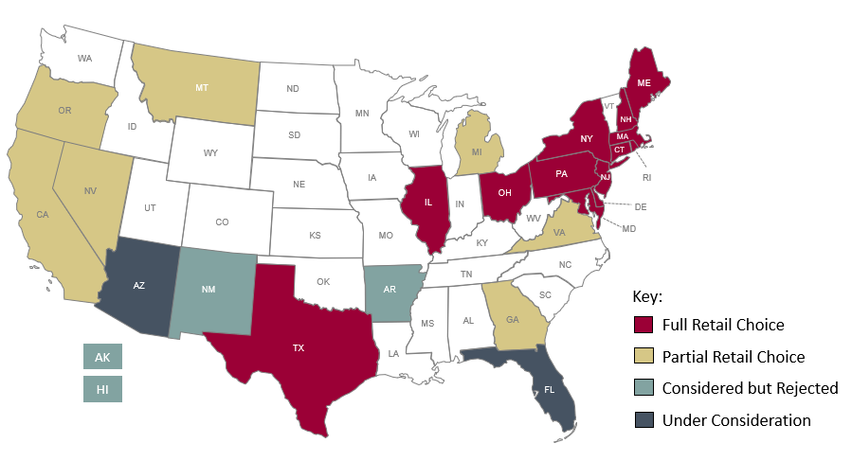
Status of Restructuring by State
Some form of retail choice is available in 21 states.
Arizona and Florida are now considering restructuring and retail choice.
3

Slide 4
Standard Features of Deregulation Proposals (the “TX Model”)
“Disintegration” of existing utilities through divestiture of generation and all customer-facing activities
Creation of deregulated wholesale power market administered through Independent System Operator
Creation of deregulated retail electric industry; shifting of all customers to a retail marketer
Shifting of regulatory responsibility for generation and transmission from state to federal agency
Creation of “wires-only” utility as intermediary between generation and retail markets
4

Slide 5
Lessons Learned
Market value of generating fleets has plunged; many units have closed
Resource adequacy and reliability have become highly problematic
Consumer interest in customer choice has been weak
Consumer protection has become challenge for AGs
Profitability and sustainability of Gencos has been poor
Wholesale power prices have become highly volatile
Retail pricing has become creative, but economic gains are hard to show

Slide 6
Analysis of Florida’s Ballot Initiative
Generation “stranded costs” of $11 billion; property tax losses would be large and unavoidable ($150 million/year)
Multiple other governmental revenue sources would be substantially at risk ($700 million/year)
Creation of wholesale market could take 3-5 years and cost $500 million, plus $200 million/year
Ballot language leaves substantial doubt if existing investor-owned utilities would be able to continue in any role
Significant increase in emissions from almost certain closure of four nuclear reactors
Loss of state jurisdiction
Power prices likely to rise by more than 10%, at least for first 10 years
State-wide economic impacts are distinctly negative
6

