Slide 1
Notes:
In 2015, the Community Foundation of Greater Birmingham approached PARCA with three questions.

Slide 2
Is Birmingham fragmented?
Does fragmentation matter?
What options do we have?
Notes:
Is Bham fragmented, and if yes, does it matter, and if it does, what options do we have?

Slide 3
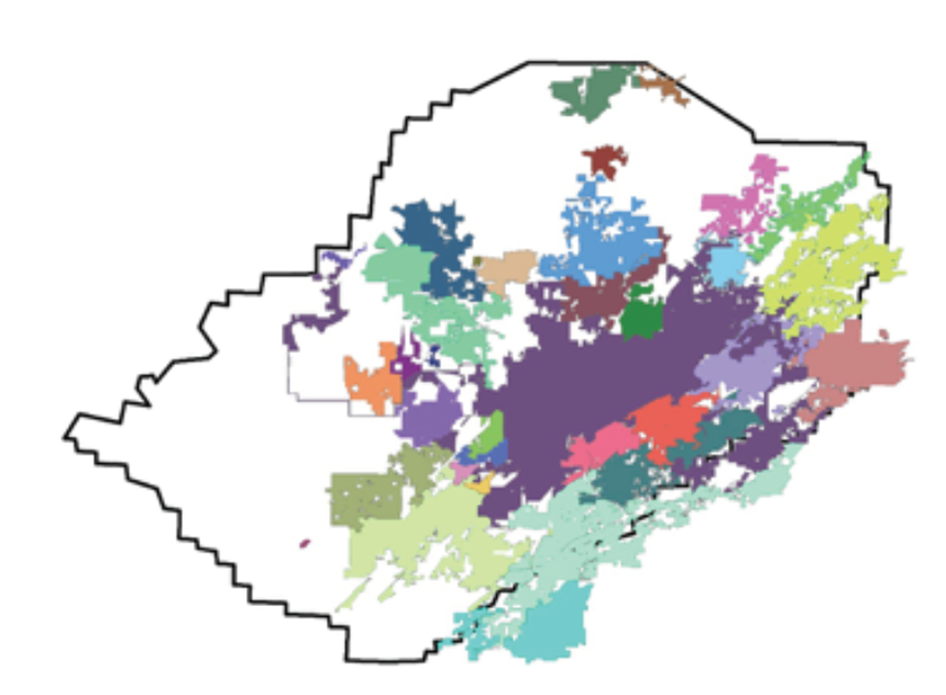
Birmingham is Fragmented
Notes:
It was widely recognized that the Birmingham area, focusing solely on Jefferson County, is highly fragmented. Here is the county map, with each of the 36 incorporated general purpose governments highlighted. Birmingham is purple, incorporated in 1871 all the way to Pinson, incorporated in 2004.

Slide 4
Birmingham is Fragmented
0.5 governments per 10,000,
#4 in southeast
1950: Birmingham 34th largest city
2017: Birmingham 104th largest city
Notes:
Those 36 general purpose governments, to say nothing of 21 school systems and other special purpose governments, make Jefferson County one of the most fragmented counties in the south. In may ways, Bham is a northern city- a withering industrial urban core surrounded by suburbs. You don’t see this model very often in the south. Consequently, you see the decline in size and influence of Birmingham. And while this is troubling to many, it is Bham’s decline relative to other cities in Alabama that often creates the most hand wringing.
We argued that fragmentation had profound negative influences.
It creates governmental duplication and complexity
It divides resources
It diffuses decision making
And it concentrates advantage and disadvantage.

Slide 5
Fragmentation Matters

Slide 6
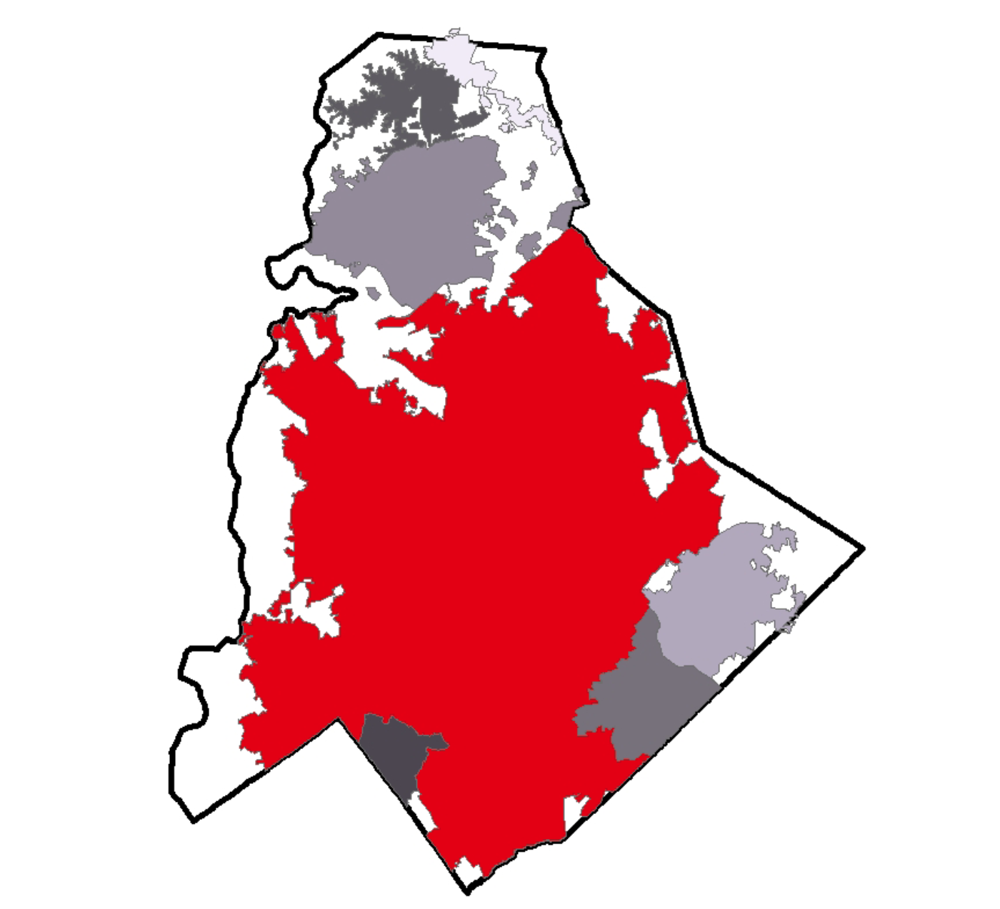
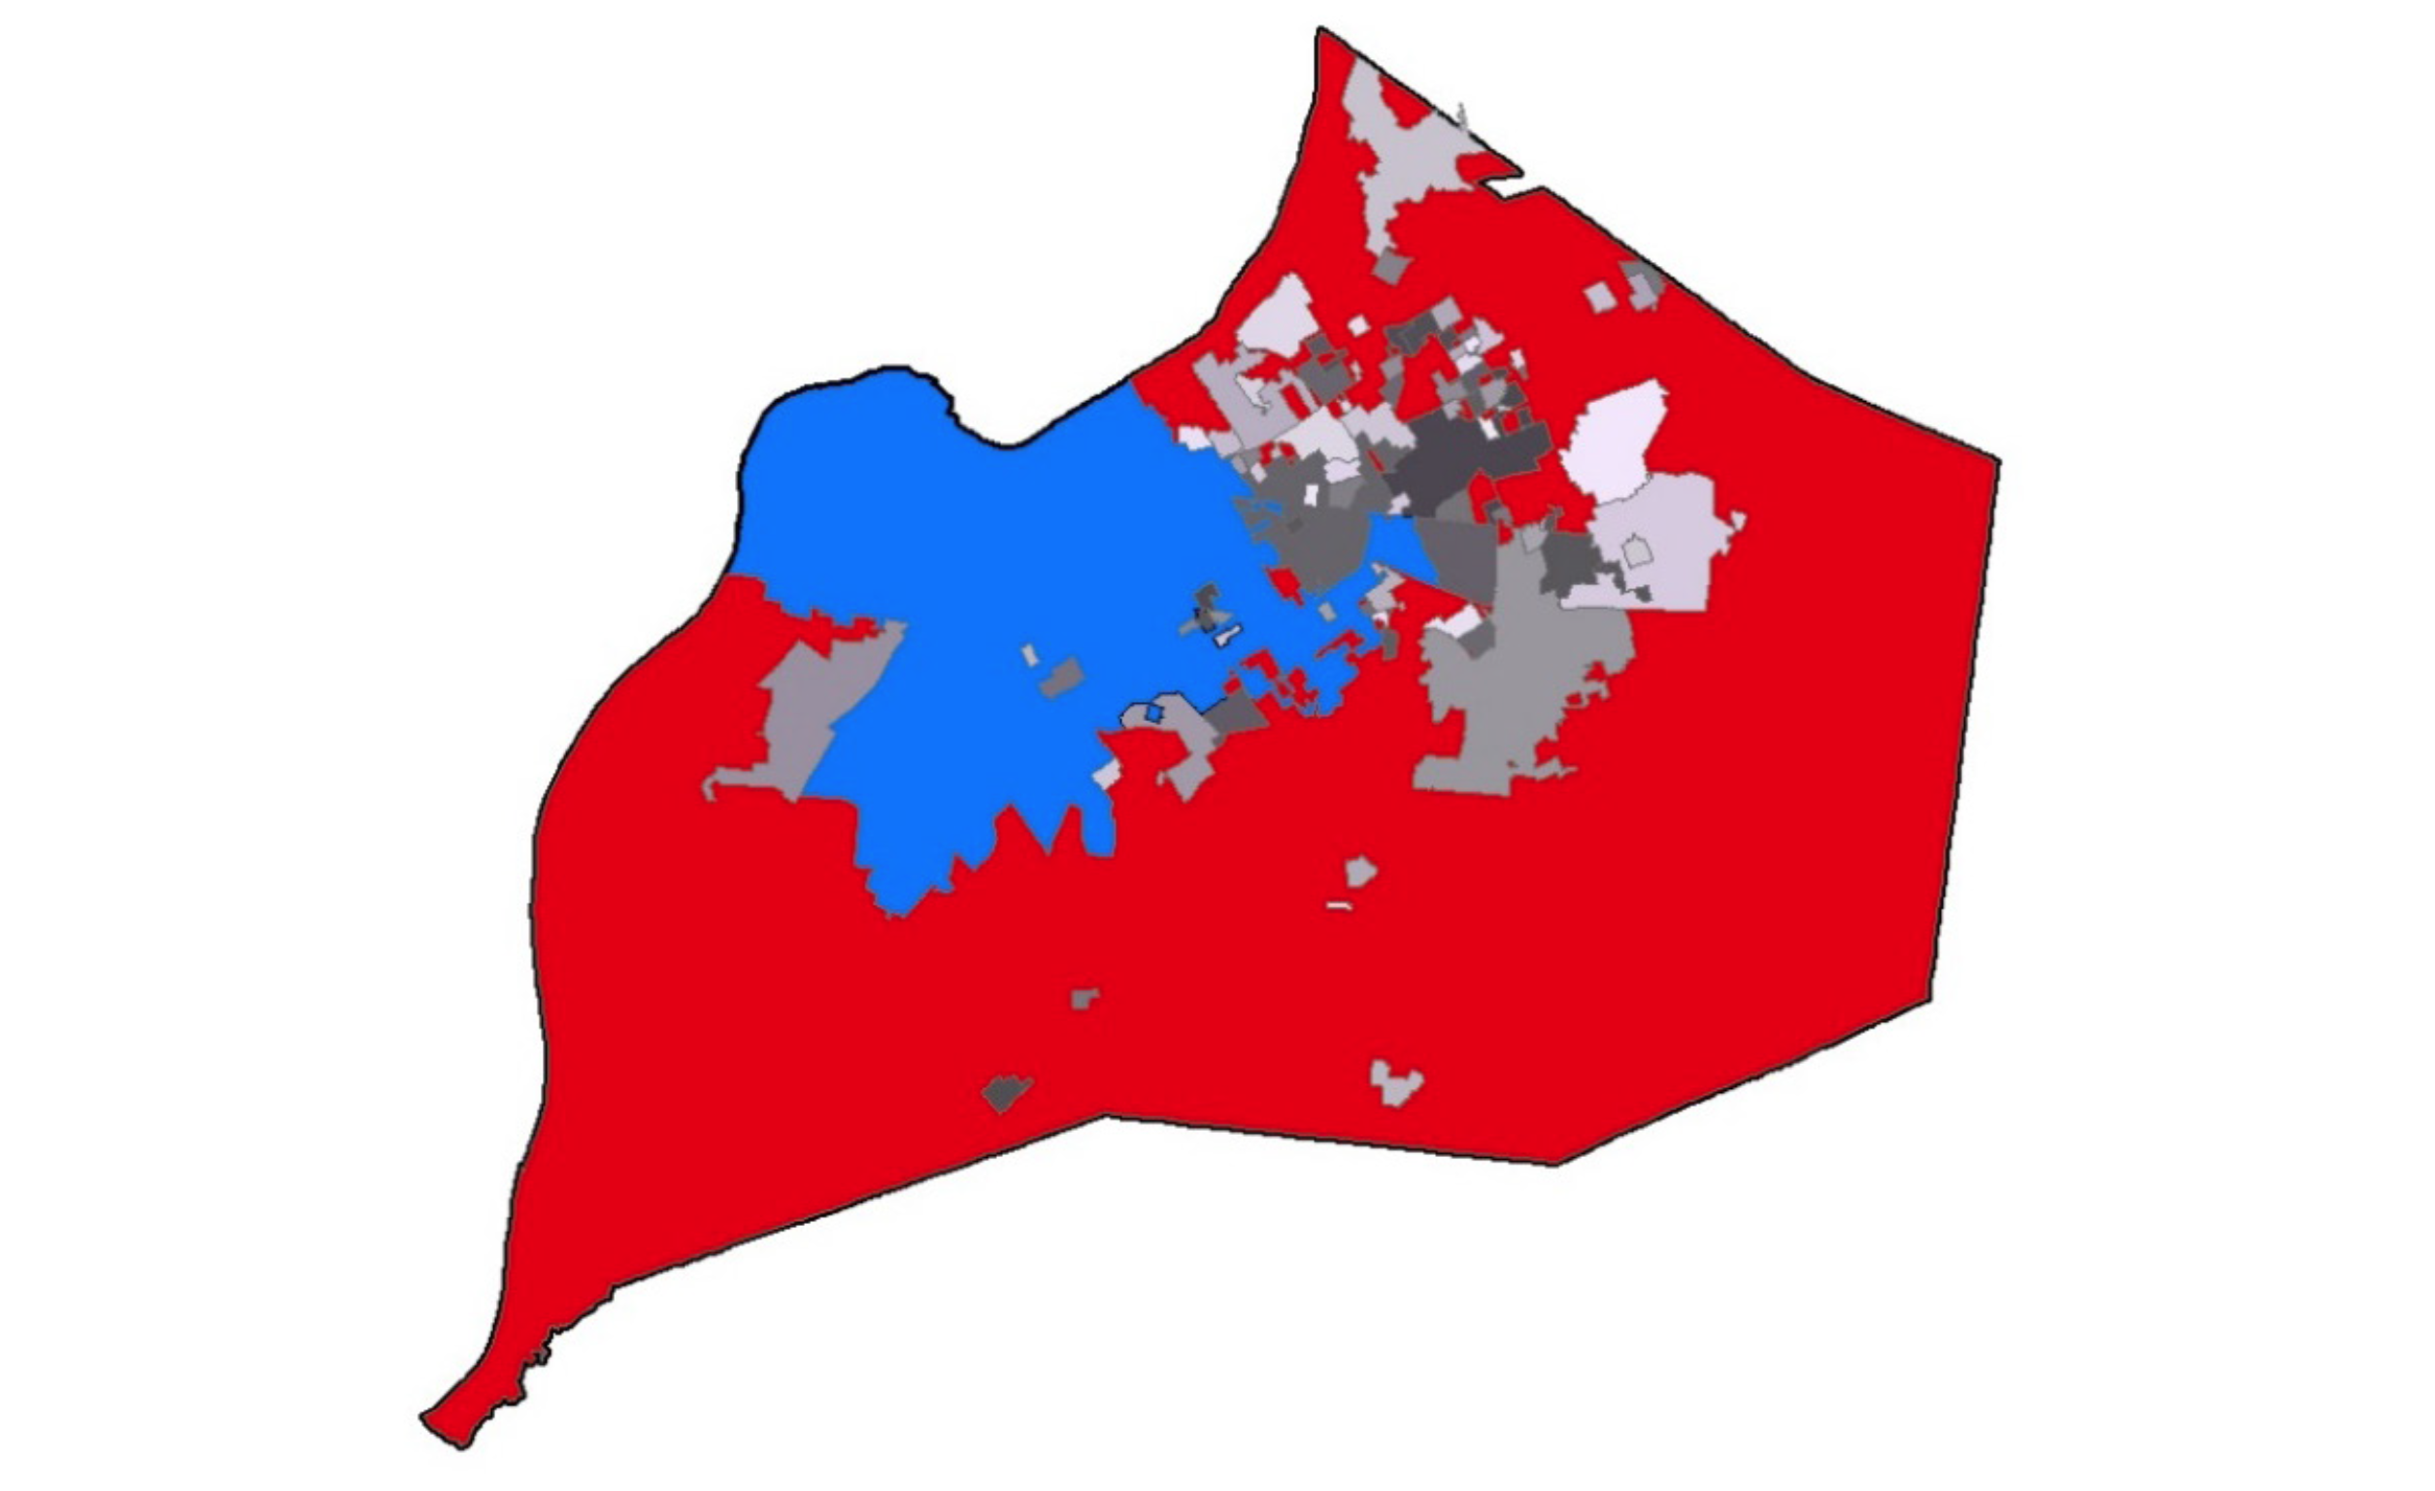
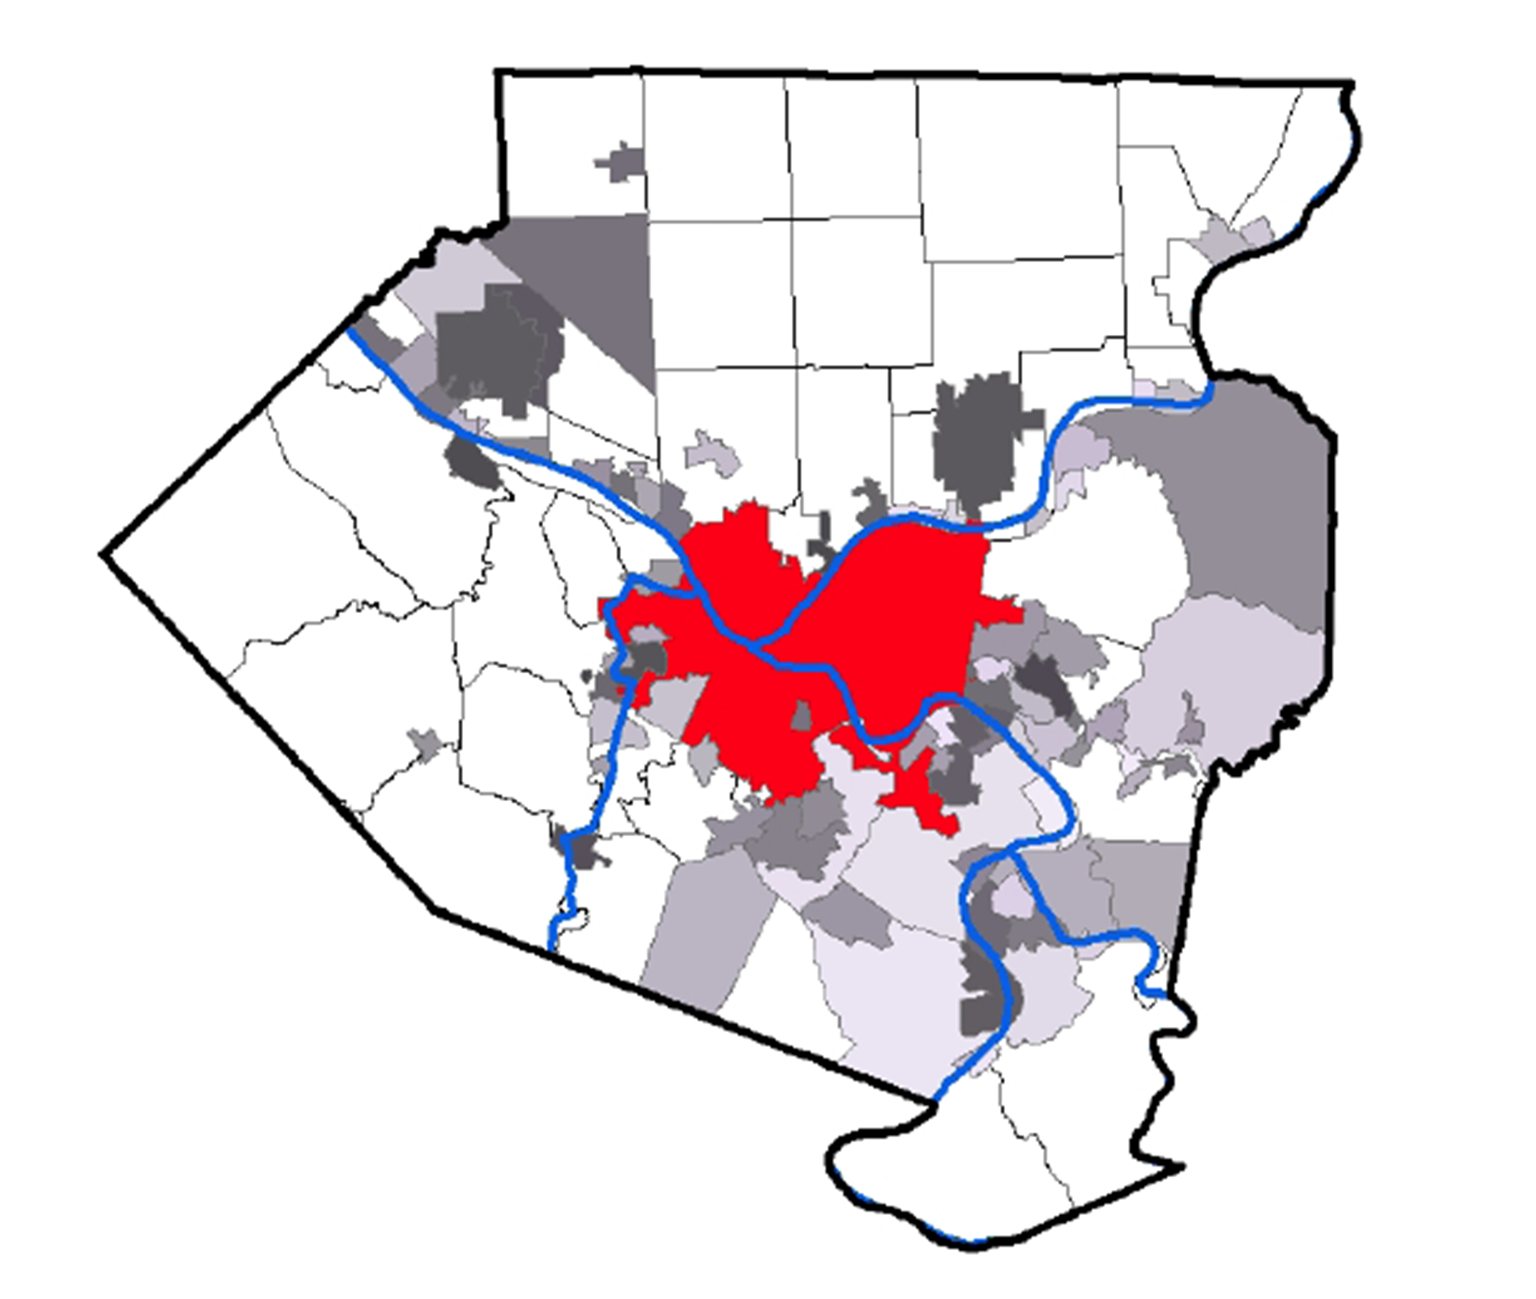
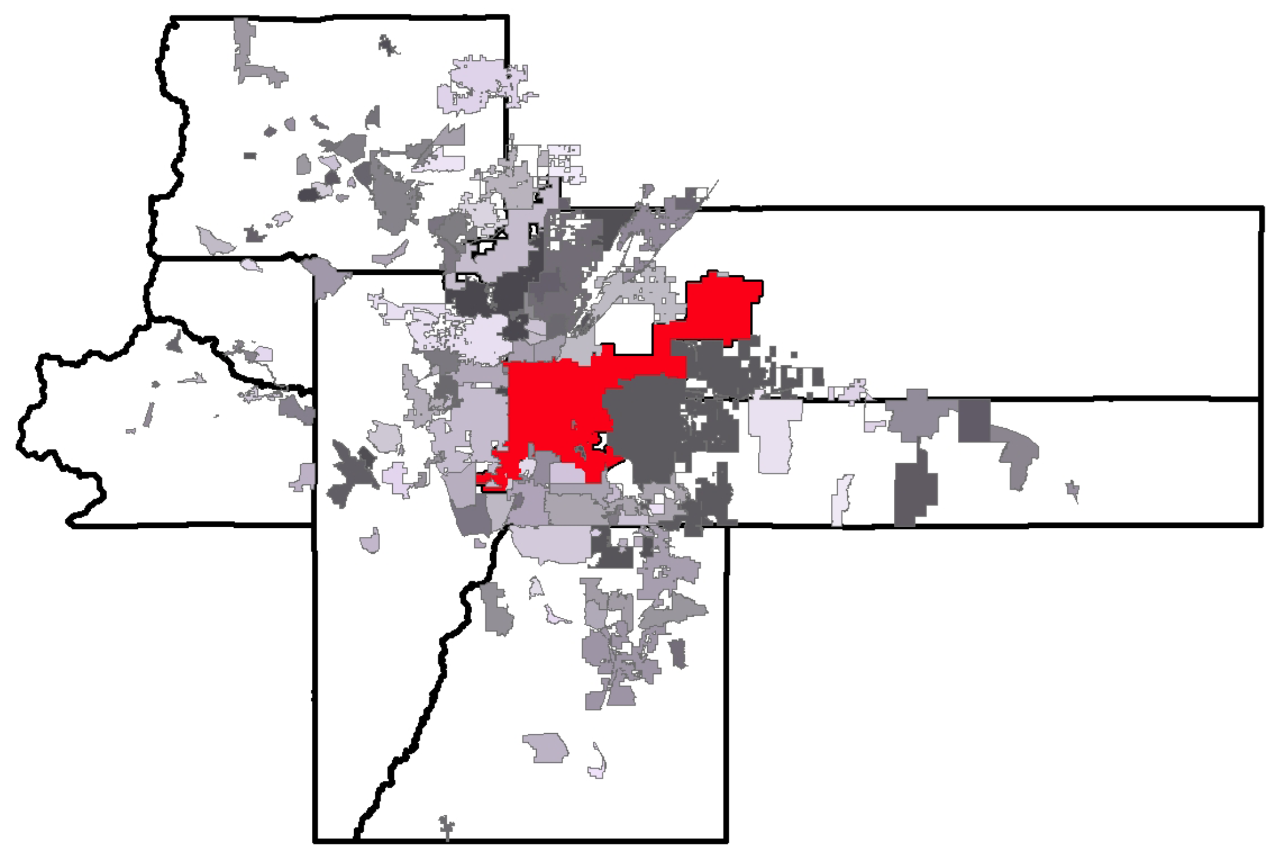
Addressing Fragmentation
Political Consolidation
Functional Consolidation
Modernization of County Government
Regional Structures

Slide 7
Response
Notes:
All this resulted in a 200+ page report and a dedicated project website
45+ presentations
50+ media stories
Radio and TV interviews
Public discussions and mock votes
Business and community leaders as soft advocates

Slide 8
Response?

Slide 9
Center of the Public Dialouge
Issue in several mayoral and council races
Discussed in civic and and business circles and events
New attention to regional problems
Notes:
As a mentioned, that the region is fragmented came as no surprise. That it had significant negative effects but that there might be ways to address them, came as a surprise to some.
Regional collaboration became part of the public conversation
Issue in several mayoral and council races
Discussed in civic and and business circles and events
New attention to regional problems

Slide 10
Outcomes

Slide 11
New Mayors = New Opportunities
Jefferson County Mayors Association
From high degree of suspicion and mistrust
To a gradual warming of relations
Notes:
With the election of several new civic leaders (and our recommendations) the local mayors association evolved from a coffee klatch to a more agenda-driven organization, but it was not with out struggle. Initial mistrust of one another and suspicion of PARCA and the Community Foundation’s motives.

Slide 12
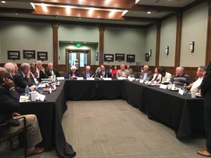
Notes:
This process concluded with a half day planning meeting facilitated by my predecessor and our founding director, Jim Williams. Jim guided the mayors to identify a single, presumably simple challenge that could be better addressed cooperatively. We thought…waste collection, expanded emergency services, etc.
The group chose an anti-poaching agreement, which they termed:

Slide 13
The Good Neighbor Agreement
A pledge not to incentive a business to relocate from a neighboring municipality.

Slide 14
The Good Neighbor Agreement
A pledge not to incentivize a business to relocate from a neighboring municipality.
Notes:
Counter-productive, unnecessary, and inefficient
Diverted resources, time and attention from recruiting new businesses to the region
A losing proposition each city and the region
We had done additional research on similar projects around the country and were able to inform and advise, but the mayors did the heavy lifting.

Slide 15
The Good Neighbor Agreement
8 largest cities agreed
Notes:
A mayor of one of the smaller cities personally called counterparts to convince them to come on board.

Slide 16
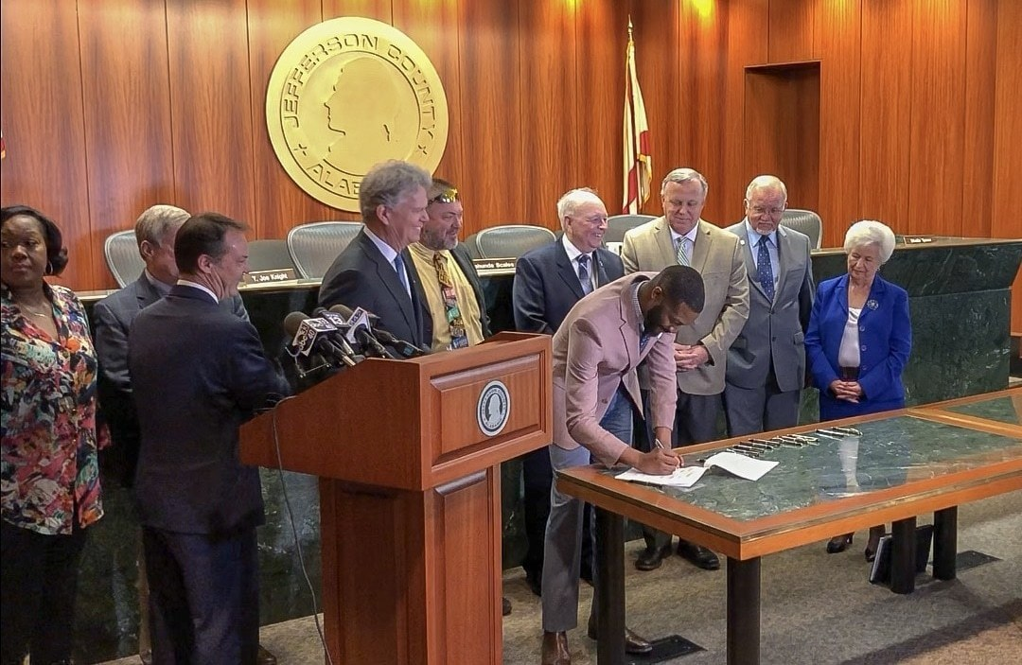
Notes:
April 3, almost a year after the planning meeting with Jim, the 8 initial mayors, plus 14 more gathered to sign the agreement.
And ironically, the signing ceremony was hosted by the county commission, who had been so skeptical of the cooperation.
They are planning to build a dispute resolution structure into the Good Neighbor Pledge.
They are talking about coming up with a comprehensive countywide or event regional listing of available office space, industrial parks, etc. which is something that should have been done a long time ago.

Slide 17
The Good Neighbor Agreement
“This is a historic achievement. Our conversations leading up to this moment are already having an impact on the way business is being done in Jefferson County….this pact will lay a better foundation for the future of our county, each of our cities, and our children and grandchildren.”
Center Point Mayor Tom Henderson, president of the JCMA
Notes:
The mayors are still working and since April, 2 more cities have joined, bringing the total to 24, and covering 87% of the incorporated population and 77% of the entire county. In a poll released Friday, 25% of area business and civic leaders say regional collaboration is the area where the most progress is seen and 91% say the region moving a better direction than 10 years ago.

Slide 18
Biggest Obstacle?
Notes:
3 of the larger cities have refused to sign because they are in a fight over….

Slide 19
Notes:
Yes, the promise of unlimited breadsticks is preventing the agreement to from covering 91% of the incorporated population.

Slide 20
P.O. BOX 293931
800 LAKESHORE DRIVE
219 BROOKS HALL
BIRMINGHAM, ALABAMA 35229
205-726-2482 PARCALABAMA.ORG Facebook: PARCA.AL
Twitter: PARCAlabama

